Slide 1
Staying Sharp Evangelistically:
The Theology Propelling Our Gospel Mission
Greg Strand
February 21-22, 2022
Allegheny District
Waterdam Church, Canonsburg, PA

Slide 2
In an age of constant distraction, Christians need to stay focused on the evangel, the good news of Jesus Christ. Our Lord has sent us on an urgent mission to declare His evangel among all people. Our EFCA Statement of Faith reminds us that “God commands everyone everywhere to believe the gospel by turning to Him in repentance and receiving the Lord Jesus Christ” (Article 10).
At Stay Sharp 2022, Greg Strand, executive director of theology and credentialing (EFCA), will help us to think more clearly and deeply about the theology that undergirds and motivates our gospel mission in the 21st century.

Slide 3
We'll explore questions like:
What is the gospel?
What is repentance?
What will be the destiny of the un-evangel-ized?
How do we declare and defend the gospel in a post-Christian secular age?

Slide 4
EFCA Statement of Faith:
God’s Gospel Quiz
New Life Through the Gospel of Jesus Christ

Slide 5
God’s gospel originates in and expresses the wondrous perfections of the eternal, triune God. God has graciously purposed from eternity to_________ a people for Himself and to make all things new for His own glory.

Slide 6
God’s gospel originates in and expresses the wondrous perfections of the eternal, triune God. God has graciously purposed from eternity to redeem a people for Himself and to make all things new for His own glory.

Slide 7
God’s gospel alone addresses our deepest need. In union with Adam, we are _________ by nature and by choice, alienated from God, and under His wrath. It is only through God’s saving work in we can be rescued, reconciled and renewed.

Slide 8
God’s gospel alone addresses our deepest need. In union with Adam, we are sinners by nature and by choice, alienated from God, and under His wrath. It is only through God’s saving work in Christ we can be rescued, reconciled and renewed.

Slide 9
God’s gospel is made known supremely in the Person of Jesus Christ, and this gospel is accomplished through the work of Christ. Jesus, Israel’s promised___ ____, lived a sinless life, was crucified and arose bodily from the dead. His atoning death and victorious ___________ constitute the only ground for salvation.

Slide 10
God’s gospel is made known supremely in the Person of Jesus Christ, and this gospel is accomplished through the work of Christ. Jesus, Israel’s promised Messiah, lived a sinless life, was crucified and arose bodily from the dead. His atoning death and victorious resurrection constitute the only ground for salvation.

Slide 11
God’s gospel is applied by the power of the Holy Spirit. The _______ convicts the world of guilt and ________ sinners, baptizing them into union with Christ and adopting them as heirs in the family of God.

Slide 12
God’s gospel is applied by the power of the Holy Spirit. The Holy Spirit convicts the world of guilt and regenerates sinners, baptizing them into union with Christ and adopting them as heirs in the family of God.

Slide 13
God’s gospel is now embodied in the new community called the church. The true church comprises all who have been _______by God’s grace through faith alone in Christ alone.

Slide 14
God’s gospel is now embodied in the new community called the church. The true church comprises all who have been justified by God’s grace through faith alone in Christ alone.

Slide 15
God’s gospel requires a response that has eternal consequences. God commands everyone everywhere to believe the_ ______by turning to Him in repentance and____ ___the Lord Jesus Christ.

Slide 16
God’s gospel requires a response that has eternal consequences. God commands everyone everywhere to believe the gospel by turning to Him in repentance and receiving the Lord Jesus Christ.

Slide 17
Introduction

Slide 18
Carl Trueman writes in “The Road to Bostock” (June 22, 2020):
The pressing pastoral need of the hour for the church is not to explain the faith to the world but rather first to explain the world to the faithful. . . . If Christians do not understand the wider context, then they will continue to underestimate the true depth of the cultural problem, be perplexed at the speed of apparent change, and be disturbed by new developments. And that will make it very hard to navigate this world as both good citizens and good stewards of the gospel.

Slide 19
David Wells concludes in Losing Our Virtue: Why the Church Must Recover Its Moral Vision (Grand Rapids: Eerdmans, 1998),
Worldliness is that system of values, in any given age, which has as its center our fallen human perspective, which displaces God and his truth from the world, and which makes sin look normal and righteousness seem strange. It thus gives great plausibility to what is morally wrong and, for that reason, makes what is wrong seem normal.

Slide 20
Sinclair Ferguson, In the Year of Our Lord: Reflections on Twenty Centuries of Church History (Sanford, Florida: Reformation Trust, 2018), “The Second Century: Troubles Inside and Outside,” 27-28:
The Christian church was under attack on two fronts – physical persecution and false teaching. On the one hand was the threat of martyrdom, and on the other was the threat of heresy. One of these enemies is much more dangerous than the other – but it is not, as we might think, persecution. The early Christians knew that martyrdom could never ultimately kill either the believer or the church. But false teaching always does.
We modern Christians tend to assume it is the other way around. We have little fear of false teaching but considerable fear of persecution. And yet, of all generations, perhaps ours is the one that should have learned to think most clearly and biblically. . . . If we find the thought of suffering for the gospel surprising, we may already have imbibed false teaching. At the very least, we have ignored biblical teaching.

Slide 21
the Power of the Gospel,
Convictional Courage, and Cancel Culture

Slide 22
Romans 1:16-17: For I am not ashamed of the gospel, for it is the power of God for salvation to everyone who believes, to the Jew first and also to the Greek. For in it the righteousness of God is revealed from faith for faith, as it is written, "The righteous shall live by faith."
Acts 5:39b-42: So they took his advice, and when they had called in the apostles, they beat them and charged them not to speak in the name of Jesus, and let them go. Then they left the presence of the council, rejoicing that they were counted worthy to suffer dishonor for the name. And every day, in the temple and from house to house, they did not cease teaching and preaching that the Christ is Jesus.

Slide 23
the transformative
Power of the Gospel

Slide 24
1 Thessalonians 1:4-10; 2:13
“For we know, brothers loved by God, that he has chosen you, because our gospel came to you not only in word, but also in power and in the Holy Spirit and with full conviction. You know what kind of men we proved to be among you for your sake. And you became imitators of us and of the Lord, for you received the word in much affliction, with the joy of the Holy Spirit, so that you became an example to all the believers in Macedonia and in Achaia.

Slide 25
For not only has the word of the Lord sounded forth from you in Macedonia and Achaia, but your faith in God has gone forth everywhere, so that we need not say anything. For they themselves report concerning us the kind of reception we had among you, and how you turned to God from idols to serve the living and true God, and to wait for his Son from heaven, whom he raised from the dead, Jesus who delivers us from the wrath to come. . . . And we also thank God constantly for this, that when you received the word of God, which you heard from us, you accepted it not as the word of men but as what it really is, the word of God, which is at work in you believers. ”

Slide 26
Cyprian of Carthage (200-258), Epistle to Donatus: Conversion – The Power of the Gospel
Lying in a dark, dismal night, utterly indecisive, tossed on this proud world’s waves, unsure of my direction, ignorant of my real life, far from truth’s light. I thought it hard – particularly for myself as I then was – that someone should be “born again.” God’s mercy had proclaimed this saving truth to me. Yet how could someone, given new life in the cleansing of salvation’s waters, put off his former life, changed in heart and soul through his body stayed the same?

Slide 27
How, I asked, is such conversion possible? Can we suddenly and swiftly strip ourselves of all that’s inborn within us, and has grown so hard through our sensual nature’s corruption? How can we discard habits that have become chronic by long custom and practice? . . . I myself was enslaved by my life’s countless errors. I didn’t believe I could possibly be liberated. So I was inclined to surrender to my clinging vices. Despairing of anything better, I gratified my sins as if they were actually parts of me, belonging to my very self.

Slide 28
But my former years’ stain was cleansed away, by the gift of the washing of new birth. A light from heaven, peaceful and pure, was poured into my heart, now reconciled with God. By the Spirit’s power breathed on me from heaven, I was born again, restored as a new man! In an amazing way, things I’d doubted began at once to become clear and certain; things I’d found dark were bathed with light; what had once seemed difficult began to seem practical; what I’d thought impossible now looked capable of being achieved. I was enabled to recognize that previously, born of the flesh, I’d been living as a sinner, entirely earthly-minded; but now I’d begun to belong to God, and was alive through the Spirit of holiness!

Slide 29
In 1522, one year after his bold confession, “Here I stand, God help me,” at Worms (April 18, 1521), Luther described how it was that the Reformation had been brought about solely by the Bible while he went about his daily routines. He writes (LW 51:77, which comes from Luther’s second Invocavit sermon delivered on March 10, 1522),
Take me, for example. I opposed indulgences and all papists, but never by force. I simply taught, preached, wrote God’s Word; otherwise I did nothing. And then, while I slept, or drank Wittenberg beer with my Philip [Melanchthon] and my [Nicholaus von] Amsdorf, the Word so greatly weakened the papacy that never a prince or emperor did such damage to it. I did nothing. The Word did it all.

Slide 30
Pastor-Theologian-Evangelist

Slide 31
Carl Henry, “Evangelism and the Sacred Book,” CT 1.1 (October 15, 1956)
The names of Karl Barth and of Billy Graham ought not, perhaps, to be mentioned in the same sentence, unless one is prepared to stay for the afternoon.
Their gifts and callings are diverse—the one a skilled theologian, the other a skilled evangelist. Their influence is equally dissimilar, that of the one mainly academic, and of the other mainly popular. Barth is today doubtless at the very apex of his career, while Graham’s star very probably is still rising.
In stressing this fact, the “theology of the Word of God” and the evangelism of “the Bible says” are in formal agreement, and share in the rebellion against the classic liberal distrust of the special revelation claim that is everywhere implicit in the Bible.
Is not the New Testament ideal (we do not imply the flawlessness of Barth’s theology nor of Graham’s evangelism) the theologian-evangelist, whom the apostle Paul supremely exemplifies.

Slide 32
Today we talk a lot about the pastor-theologian, but not much at all about the pastor-evangelist or the theologian-evangelist. I wonder why? I think we need to focus on all: pastor-theologian-evangelist. It is a long, hyphenated mouth-full, but I think it captures what we are to be about.
John Woodbridge: I love your suggestion--the use of the expression, “pastor-theologian-evangelist”. There is a wonderful rationale to be unfurled regarding the reasons such an expression is most pertinent. You may remember I discussed Henry's embrace of the expression “Theologian Evangelist” in an article in the book, The Enduring Influence of Carl F. H. Henry. His justification for the use of that expression was very persuasive.

Slide 33
A Postmodern, Increasingly
Post-Christian Creed:
Yard-sign Theology

Slide 34
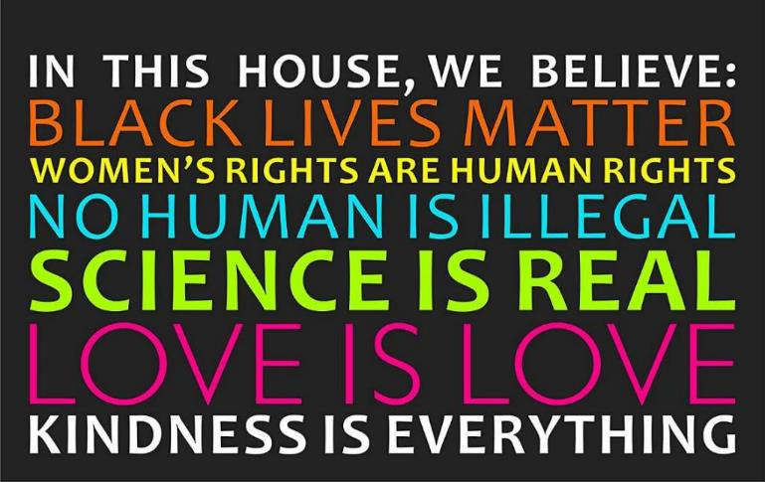

Slide 35
We believe in one God, the Father almighty . . . And in one Lord Jesus Christ, the only Son of God, begotten from the Father before all ages . . . And we believe in the Holy Spirit, the Lord, the giver of life. He proceeds from the Father and the Son . . . (Nicene Creed)
Brett McCracken, Your Neighbor’s New Creed: ‘In This House, We Believe . . .’

Slide 36
Pisidian Antioch and Athens: “What does Jerusalem have to do with Athens?”

Slide 37
Pisidian Antioch (Acts 13:13-43)
This address was given by Paul to those who were primarily Jewish who knew their Bibles (Old Testament) well.
The focus is Jesus: the Old Testament recorded the preparation for Christ, and Paul proclaimed that those Scriptures were fulfilled in Christ, and he concludes with a call to faith in Christ.

Slide 38
Athens (Acts 17:16-34)
This address was given by Paul to those who were primarily pagan who knew nothing of the Bible at all.
Paul’s reactions were based on a Christian analysis of culture, not the beauty of the city (17:16). When he saw the idols he was distressed.

Slide 39
Paul was engaged in proclamation, not dialogue (17:18). His focus was on the message about the Good News of Jesus, not the method. He also addressed the prevailing philosophies of life - Epicureanism (Epicurus (341-270 B.C.) founded this movement. Pleasure was considered the chief end of life, which consisted of a life of tranquility, free from pain, disturbing passions, and superstitious fears. They did not deny the existence of gods, but concluded that the gods took no interest in the life of mankind.) and Stoicism (Cypriote Zeno (340-265 B.C.) was the founder. Followers sought to live consistently with nature, and in practice they laid great emphasis on the primacy of the rational faculty in man, and on individual self-sufficiency, which led to pride. Generally, proponents were pantheistic.)
At the Areopagus, Paul addressed them with courtesy, but with restraint; there is no approval of their religion as another way of salvation. He does, however, acknowledge the basic religiosity of man (17:22).

Slide 40
Paul begins his proclamation “To an unknown God” (17:23). He uses something in their midst to bring them to the Gospel. What is unknown to them, he will make known the God who has revealed Himself. He states the heart of the issue: worship.
God is separate from the universe. He is the Creator, He is sovereign, and He is transcendent (17:24).
Not only does God sustain life and rule providentially, He is also characterized by aseity (from the Latin a se meaning “from Himself,” 17:25). God is independent which means He does not need us. We cannot give Him anything He lacks.

Slide 41
All of humanity has descended from one man, who was also created by God (17:26). If there is a God, He is God of all, acknowledged or not.
God orders all of history, and His purpose is that human beings might know Him in order to worship Him (17:27). God is also personal. This has to do with a worldview.
Paul could even quote some of their own pagan poets - the Creten Epimenides and the Cilician Aratus - as they supported the Gospel message, for all truth is God’s truth (17:28). He does use these quotes from a biblical and Christian perspective.

Slide 42
Paul addresses human rebellion against the Creator, Ruler, Sustainer God (17:29-30).
Paul commands all people everywhere to repent (17:30).
History is moving to the day of final judgment (17:31).
The judgment will come about by the Judge Jesus who was raised from the dead (17:31). Jesus is not mentioned until this point, and then not even by name.

Slide 43
What are some things we can learn from Paul’s proclamation of the never-changing message in two different contexts? What are some things we can learn from them for proclaiming the Gospel in our own day?
Since worship of God, and growing in Him are (super)natural for the Christian, so is it (supernatural) for the believer to share the good news with others, the latter rooted in and flowing from the former.
You have heard the statement, “Always share the gospel. And if you have to, use words.” It is simply not true. Our lives are rooted in the gospel, and our lives do not make sense apart from the gospel. This means that what will distinguish our lives from other good, moral people is the gospel!

Slide 44
We live in a different day than when most of us grew up. We no longer live in a “modern” day, but we live in a “post-modern” day, and we no longer live in a “Christian” culture, but we live in an increasingly postChristian culture where there is no truth and the greatest sin (if there is such a thing) is intolerance.
Sharing the gospel with others is arrogant and considered a form of harassment or abuse.
The Bible’s story-line is not known by many people. This has implications for how we communicate the Gospel with people.
We do not have a plan for evangelism. Our Christian lives are compartmentalized so evangelism, just like faith, is one part that we need to add to an already-too-busy-schedule.
Theologically we are exclusivists; practically we are universalists.
We fall into one of two errors: either we need to save people, or God will save people on His own without us.
This is ultimately about God’s glory and worship.

Slide 45
We are committed to convictional kindness:
  convictional because we affirm unflinchingly the faith once for all entrusted to the saints (Jude 3),
  and we do so with kindness, as that is a fruit of the Spirit (Gal. 5:22-23). We both affirm with the truth of the Scriptures, and we reflect in life the truth we proclaim with our lips.
We affirm . . .
  orthodoxy, right belief,
  orthopraxy, right behavior based on that belief,
  and orthocardia, a right heart created by the gospel and manifested in love for God and love for others.

Slide 46
God’s Gospel

Slide 47
What do you mean by the “gospel”?
In its simplest form, the gospel is the message that Jesus Christ died for our sins, was buried and rose again, all according to the Scriptures (1 Cor. 15:1-4). Though this is the gospel, it is also so much more. This is evident in the book of Romans, Paul’s writing that most significantly and intentionally focuses on theology and missiology. Not only does he begin the book with an emphasis on “God’s gospel” (1:1-4), but the gospel also serves as the structure and theme of the whole book (1:16-17). This means that God’s gospel is focused on the truth of 1 Corinthians 15:1-5. But, in addition to this, it means that God’s gospel is the message of His saving purpose which culminates in the coming of His Son Jesus Christ and which will be brought to completion when His Son comes again in glory.

Slide 48
The basic elements in the gospel message were these:
the prophecies have been fulfilled and the new age inaugurated by the coming of Christ;
he was born into the family of David;
he died according to the Scriptures, to deliver his people from this evil age;
he was buried, and raised again the third day, according to the Scriptures;
he is exalted at God’s right hand as Son of God, Lord of living and dead;
he will come again, to judge the world and consummate his saving work.

Slide 49
Here is how Tim Keller helpfully defines and delineates the gospel:
the gospel' is not just a way to be saved from the penalty of sin, but is the fundamental dynamic for living the whole Christian life--individually and corporately, privately and publicly. In other words, the gospel is not just for non-Christians, but also for Christians. This means the gospel is not just the A-B-C's but the A to Z of the Christian life. It is not accurate to think 'the gospel' is what saves non-Christians, and then, what matures Christians is trying hard to live according to Biblical principles. It is more accurate to say that we are saved by believing the gospel, and then we are transformed in every part of our mind, heart, and life by believing the gospel more and more deeply as our life goes on.

Slide 50
The Trinity: The God Behind the Gospel

Slide 51
Fred Sanders, The Trinity: The God Behind the Gospel, Credo Magazine 3.2 (April 2013).
When people get saved, they don’t usually notice that something trinitarian has happened to them. But “something trinitarian” is precisely what goes on in salvation: Everyone who has saving faith has been drawn by the Father (John 6:44) and moved by the Spirit to confess that Jesus is Lord (1 Cor. 12:3). To be forgiven is to be justified by the just One when the Father put forward his Son as a propitiation to be received by faith (Rom. 3:24-5). God’s great blessing to us in Christ is a single, massive, unified act of choosing us before the foundation of the world, redeeming us through the blood of his beloved Son, and sealing us with the Holy Spirit of promise (Eph. 1:3-14).

Slide 52
Wherever you turn in the doctrine of salvation, you encounter the integrated work of the Father, Son, and Holy Spirit, the concerted undertaking of a great salvation that is purposed by the Father, accomplished through the Son, and applied by the Holy Spirit. Perhaps it is never more conspicuously displayed than when we look at salvation through the lens of adoption. Here the trinitarian character of salvation shines through constantly: the Son is not ashamed to call us brothers, but brings us into that same filial relationship with the Father that he himself has. The eternal Son becomes the incarnate Son in order to bring creatures into a sonship relation to the Father, through the indwelling Spirit of adoption.

Slide 53
What he always has been in heaven, the one in whom the Father is well pleased, he begins to be on earth, among us, in the likeness of sinful flesh. Exalting fallen creatures into that filial relationship is not easy, and is no mere matter of course. It costs. The Father loves the world so much that he gives his Son (John 3:16), and the Son offers himself to the Father through the eternal Spirit to make this happen (Heb. 9:14). J. I. Packer has said that the theology of the New Testament can be summed up in three words: “Adoption through propitiation.” The Trinity pays the price of bringing us home to God.

Slide 54
Jesus himself seems to have indicated this trinitarian depth of Christian existence when he commissioned his church to make disciples of all nations by baptizing them “in the name of the Father, Son, and Holy Spirit” (Matt. 28:20). These three names, or rather this one divine name that points to three distinct persons, is spoken over every person brought into the church. It is not merely a formula to be recited for its own sake, but a kind of summary of the gospel, explaining the depths beneath what every believer experiences in salvation. What Paul calls “the gospel of God” is a gospel about the one who was declared to be God’s Son by his resurrection through the Spirit (Rom. 1:1-4). When we encounter the gospel of God, the reality we come into contact with is the God of the gospel, and it is the task of the doctrine of the Trinity to explain that connection.

Slide 55
Although the triunity of God is behind everything that happens in salvation, and the gospel only makes sense when it is traced back to its trinitarian foundation, the doctrine of the Trinity is nevertheless not simply a sort of codified account of our spiritual experience, or a belief that we can read right off of our spiritual experience. It gives rise to an experience of God, but it does not derive from an experience. Trinity grounds experience rather than vice versa. The idea that we could read doctrines directly off our spiritual experience was a hallmark of classical theological liberalism, and did not normally promote the health of the doctrine of the Trinity (see the treatments of the doctrine by Schleiermacher and Ritschl, for instance).

Slide 56
That is the right way to interpret the Bible. It’s also the traditional way, recognized by the church fathers and the reformers. It’s also the Christian way. It yields the doctrine of the Trinity, not in scattered verses here and there that tell us a weird doctrine at the margins of the faith, but as the main point of the whole history. In the fullness of time, God sent his Son (Gal 4:4), a Son he always had with him in the unity of the Spirit. And having sent his Son to redeem us from the curse of the law, he sent the Spirit of his Son into our hearts crying “Abba, Father” (Gal 4:6).

Slide 57
Taking the big view of how we know the details of the doctrine of the Trinity helps explain the odd situation we started with: that everyone who gets saved has had this deeply trinitarian experience, but few notice the trinitarian character of it. When we get saved, we are immersed into a trinitarian reality, but we need to have that reality explained and expounded to us. God gives us the gift of salvation, and completes the gift by giving us understanding of it: “we have received… the Spirit who is from God, that we might understand the things freely given us by God” (1 Cor 2:12). God gives the Spirit of adoption, the Spirit without whom we do not belong to Christ, and also gives the Spirit who helps us understand the gift: same Spirit. The God behind the gospel is the Trinity, and wants us to know that.

Slide 58
Scripture:
Gospel Witness

Slide 59
Genesis 3:15: I will put enmity between you and the woman, and between your offspring and her offspring; he shall bruise your head, and you shall bruise his heel."
Genesis 12:2-3: And I will make of you a great nation, and I will bless you and make your name great, so that you will be a blessing. I will bless those who bless you, and him who dishonors you I will curse, and in you all the families of the earth shall be blessed." (cf. Matt. 28:18-20)
Isaiah 52:7: How beautiful upon the mountains are the feet of him who brings good news, who publishes peace, who brings good news of happiness, who publishes salvation, who says to Zion, "Your God reigns.“ (cf. Isa. 61:1-2; Lk. 4:18-19)

Slide 60
Luke 2:10-11: And the angel said to them, "Fear not, for behold, I bring you good news of great joy that will be for all the people. For unto you is born this day in the city of David a Savior, who is Christ the Lord.
Mark 1:14-15: Now after John was arrested, Jesus came into Galilee, proclaiming the gospel of God, and saying, "The time is fulfilled, and the kingdom of God is at hand; repent and believe in the gospel."
Philippians 2:9-11: Therefore God has highly exalted him and bestowed on him the name that is above every name, so that at the name of Jesus every knee should bow, in heaven and on earth and under the earth, and every tongue confess that Jesus Christ is Lord, to the glory of God the Father. (cf. Jn. 14:6; Acts 4:12; 1 Tim. 2:5)
Acts 1:8: But you will receive power when the Holy Spirit has come upon you, and you will be my witnesses in Jerusalem and in all Judea and Samaria, and to the end of the earth."

Slide 61
1 Peter 3:14-16: But even if you should suffer for righteousness' sake, you will be blessed. Have no fear of them, nor be troubled, but in your hearts honor Christ the Lord as holy, always being prepared to make a defense to anyone who asks you for a reason for the hope that is in you; yet do it with gentleness and respect, having a good conscience, so that, when you are slandered, those who revile your good behavior in Christ may be put to shame.
Matthew 24:14: And this gospel of the kingdom will be proclaimed throughout the whole world as a testimony to all nations, and then the end will come. (Cf. Rev. 7:9-10; 11:15)
2 Thessalonians 1:5-10: This is evidence of the righteous judgment of God, that you may be considered worthy of the kingdom of God, for which you are also suffering--since indeed God considers it just to repay with affliction those who afflict you, and to grant relief to you who are afflicted as well as to us, when the Lord Jesus is revealed from heaven with his mighty angels in flaming fire, inflicting vengeance on those who do not know God and on those who do not obey the gospel of our Lord Jesus. They will suffer the punishment of eternal destruction, away from the presence of the Lord and from the glory of his might, when he comes on that day to be glorified in his saints, and to be marveled at among all who have believed, because our testimony to you was believed. (cf. Rev. 22:12-21)

Slide 62
EFCA Statement of Faith
Our Convictions Relate to the Evangel, the Gospel

Slide 63
Evangelical Convictions: A Theological Exposition of the Statement of Faith of the Evangelical Free Church of America, “Introduction,” pp. 20-21.
Our goal in formulating this Statement was to set forth “sound doctrine that conforms to the glorious gospel of the blessed God,” which he has now entrusted to us (1 Tim. 1:10-113). We believe that our essential theological convictions are vitally connected to this gospel.
What is the gospel? The Apostle Paul describes this good news concisely as the declaration that “Christ died for our sins according to the Scriptures, that he was buried, that he was raised on the third day according to the Scriptures” (1 Cor. 15:3-4). This certainly is the heart of the message, but when we proclaim this message, we say much more than this. In a sense, the ten articles of our Statement unpack this simple message of good news by setting forth our central theological convictions in a way that follows the logic of the gospel itself.

Slide 64
First, we recognize this as God’s gospel, inasmuch as it comes from God and not from any human source. This message begins with God’s eternal purpose to redeem a people for himself, a purpose flowing from his own nature.
Second, this gospel is “according to the Scriptures,” as Paul declares, and it comes to us authoritatively through God’s Word in the Bible.
Third, because it deals with our sin, God’s gospel alone can address our deepest need.

Slide 65
In Articles four through six we contend that this gospel is revealed in the Person of Jesus Christ, is accomplished through the work of Christ and becomes effective in and for us through the application of Christ’s work by the power of the Holy Spirit.
Seventh, in our union with Christ by the Spirit we are joined to a new community of fellow believers in the body of Christ, the church.
As asserted in Article 8, the new life which the gospel imparts to us compels us to live in a new way. We are to love God and our neighbor and bear witness to the gospel in word and deed.

Slide 66
This is our calling until God’s saving purpose is fulfilled in the glorious return of Christ, until which time we give ourselves to godly living, sacrificial service and energetic mission and (Article 9).
Finally, in Article 10, we affirm that this coming of Christ will bring with it not only the judgment of the world but also our bodily resurrection and the renewal of all things in the new heaven and the new earth. This is God’s gospel, and this good news requires a response. We are to turn to God in repentance and faith, receiving the Lord Jesus Christ as our Savior.

Slide 67
Thus, the various topics covered in our Statement—God, the Bible, the Human Condition, the Person of Christ, the Work of Christ, the Holy Spirit, the Church, the Christian Life, the Return of Christ, and the Response and Eternal Destiny—reflect this logical unfolding of the gospel.
Our Statement of Faith is an expanded statement of the gospel. We do not claim that, to be saved, a person must understand and believe all that this Statement contains, but we do believe that it contains the truth that makes our salvation possible and the truth that tells us what our salvation means.
We contend that such a connection to God’s saving work in the gospel ought to be the primary means of determining the core doctrines of our faith.

Slide 68
EFCA Statement of Faith:
Article 10: Christ’s Return

Slide 69
We believe that God commands everyone everywhere to believe the gospel by turning to Him in repentance and receiving the Lord Jesus Christ. We believe that God will raise the dead bodily and judge the world, assigning the unbeliever to condemnation and eternal conscious punishment and the believer to eternal blessedness and joy with the Lord in the new heaven and the new earth, to the praise of His glorious grace. Amen.

Slide 70
I. God’s Gospel Requires a Response

Slide 71
A. God Commands Us to Respond

Slide 72
B. The Gospel Addresses Everyone Everywhere

Slide 73
C. We Are to Believe the Gospel

Slide 74
1. We Are to Turn to God in Repentance

Slide 75
2. We Are to Receive the Lord Jesus Christ

Slide 76
II. Our Eternal Destiny
God Will Raise the Dead Bodily
God Will Judge the World
  The Destiny of the Unbeliever: Condemnation and Eternal Conscious Punishment
  The Destiny of the Believer
    Eternal Blessedness and Joy with the Lord
    In the New Heaven and the New Earth

Slide 77
II. Our Eternal Destiny
God Will Raise the Dead Bodily
God Will Judge the World
  The Destiny of the Unbeliever: Condemnation and Eternal Conscious Punishment
  The Destiny of the Believer
    Eternal Blessedness and Joy with the Lord
    In the New Heaven and the New Earth

Slide 78
III. God’s Final Purpose: To the Praise of His Glorious Grace
IV. Our Final Response: Amen

Slide 79
Evangelism: Definition

Slide 80
1918 Anglican: “To evangelise is so to present Christ Jesus in the power of the Holy Spirit, that men shall come to put their trust in God through him, to accept him as their Saviour, and serve him as King in the fellowship of his church.”

Slide 81
Trinitarian emphasis, “Christ Jesus,” Holy Spirit,” “God”
Focus on “Jesus” as “Christ” (anointed), “Savior” (salvation), and “King” (ruler)
“power of the Holy Spirit” refers to the application of the finished work of Christ
“Trust” captures the sense of believe or faith, the instrumental means of conversion
“Accept him” emphasizes a subjective response, a conscious commitment
“serve him” reflects what we are saved for and the need to continue trusting and following Jesus
“fellowship of his church” is the goal of conversation, to create a new community which is corporate
BUT, “that men shall” means evangelism has not happened unless someone is converted, meaning it is defined by results.

Slide 82
D. T. Niles, a theologian from Ceylon (now Sri Lanka), (That They May Have Life, 1951):
Evangelism is witness. It is one beggar telling another beggar where to get food.

Slide 83
Bill Bright, CRU (formerly Campus Crusade for Christ, wrote the 4 Spiritual Laws in 1956):
Success in witnessing is simply taking the initiative to share Christ in the power of the Holy Spirit, and leaving the results to God.

Slide 84
1974 Lausanne Covenant:
To evangelize is to spread the good news that Jesus Christ died for our sins and was raised from the dead according to the Scriptures, and that as the reigning Lord he now offers the forgiveness of sins and the liberating gift of the Spirit to all who repent and believe. (4. The Nature of Evangelism)
World evangelization requires the whole Church to take the whole gospel to the whole world. (6. The Church and Evangelism)

Slide 85
4. THE NATURE OF EVANGELISM
To evangelize is to spread the good news that Jesus Christ died for our sins and was raised from the dead according to the Scriptures (1 Corinthians 15:3,4), and that, as the reigning Lord, he now offers the forgiveness of sins (Acts 2:32-39) and the liberating gifts of the Spirit to all who repent and believe (John 20:21). Our Christian presence in the world is indispensable to evangelism, and so is that kind of dialogue whose purpose is to listen sensitively in order to understand. But evangelism itself is the proclamation of the historical, biblical Christ as Saviour (1 Corinthians 1:23; 2 Corinthians 4:5) and Lord, with a view to persuading people to come to him personally and so be reconciled to God (2 Corinthians 5:11,20). In issuing the gospel invitation we have no liberty to conceal the cost of discipleship (Luke 14:25-33). Jesus still calls all who would follow him to deny themselves, take up their cross (Mark 8:34), and identify themselves with his new community. The results of evangelism include obedience to Christ, incorporation into his Church (Acts 2:40,47) and responsible service in the world (Mark 10:43-45).

Slide 86
Timothy K. Beougher, Invitation to Evangelism: Sharing the Gospel with Compassion and Conviction (Kregel, 2021), 9,
the compassionate sharing of the good news of Jesus Christ with lost people, in the power of the Holy Spirit, for the purpose of bringing them to Christ as Savior and Lord, that they in turn might share him with others.

Slide 87
The Spirit of Evangelism: Compassion (Matthew 9:36)
The Method of Evangelism: Sharing (Acts 8:35)
The Content of Evangelism: The Good News of Jesus Christ (Luke 2:10)
The Recipients of Evangelism: Lost People (Luke 19:10)
The Power of Evangelism: The Holy Spirit (Acts 1:8)
The Purpose of Evangelism: Bringing Them to Christ as Savior and Lord (Acts 16:31)
The Goal of Evangelism: A New Community/Church (1 Peter 2:9-10)
The Perpetuation of Evangelism: They Win Others (2 Timothy 2:2)

Slide 88
Trevin Wax, Why the Gospel Community is Essential to Understanding the Gospel:
If you excise the gospel community from your thinking about the gospel announcement, you gut the gospel of its purpose. Though the church is not the subject of the gospel announcement (Christ alone is the subject, of course), the church is a necessary object. Christ’s death has a purpose: to save sinners and incorporate them into a community that reflects His glory.
the gospel has a telos – the purpose of calling out a people, which is why I want to keep “gospel community” close to the announcement. I fear that most evangelicals see the church as ‘just an implication of the gospel’ instead of thinking, This is the whole point of the good news – God forming a people for His glory and the good of the world.

Slide 89
Evangelicalism:
Born Again

Slide 90
An influential author of was pastor Johann Arndt (1555-1621) who wrote True Christianity. His Pietism emphasized regeneration– the necessity to be born again.
The läsare / læsere (Readers’) movement (18th century) promoted: Being born again is “the one thing needful.”
American Revivalism followed the Puritan-Pietist revival traditions of Jonathan Edwards, George Whitefield, and John Wesley (18th century), emphasizing the Bible’s authority and need to be born again.
Charles Grandison Finney (1792-1875), who was part of the Second Great Awakening (mid-19th century), said, “religion is the work of man, it is something for man to do.” One of his “new measures” was the “anxious bench,” in which he put a pew at the front of the church, where those who felt a special urgency about their salvation could sit. Some historians consider him the “father of modern revivalism.”

Slide 91
David Bebbington: Bebbington Quadrilateral
Biblicism: the ultimate authority of the Bible
Crucicentrism: a Christ-centered and cross-focused emphasis on the atoning work of Christ
Conversionism: the commitment that one must be converted, born again
Activism: conversion is expressed in in a changed life in love for God and others in “good works”

Slide 92
Thomas S. Kidd, Who Is An Evangelic ? The History of a Movement in Crisis (Yale, 2019), 4:
Evangelicals are born-again Protestants who cherish the Bible as the Word of God and who emphasize a personal relationship with Jesus Christ through the Holy Spirit.

Slide 93
Charles Colson, Born Again (1976)
Newsweek, “Born Again! The Evangelicals” (1976)
Billy Graham, How to Be Born Again (1977)
Newsweek, “Born Again” (1978)
Rachel Gilson, Born Again This Way: Coming Out, Coming to Faith, and What Comes Next (2020)

Slide 94
Evangelistic methods

Slide 95
1950s: Billy Graham crusades
1960s: visitation evangelism (EE)
1970s: church growth (Fuller Theological Seminary)
1980s: church planting
1990s: seeker-sensitive and emergent
2000s: belonging before believing (Alpha) and missional

Slide 96
Motivation for Evangelism
Lausanne Occasional Paper 21:
Evangelism and Social Responsibility:
An Evangelical Commitment
June 25, 1982

Slide 97
There are many incentives to evangelism. To begin with, there is simple obedience to the Great Commission, and to the Lord of the Great Commission, to whom all authority has been given (Matt. 28:18-20). Then there is the terrible knowledge we have that human beings without Christ are lost or “perishing” (e.g., John 3:16; 1 Cor. 1:18), and our earnest desire in love to reach them with the gospel before it is too late. Another powerful motive is zeal or “jealousy” for the glory of Christ, whom God has super-exalted in order that every knee should bow to him and every tongue confess him Lord (Phil. 2:9-11).
Yet we believe that the most basic of all motives lies in the very nature of God himself, and in his saving work by which he revealed himself. We do not exaggerate when we affirm that the living God is a missionary God. He created all humankind, is “the God of the spirits of all flesh”, and when calling Abraham promised through his posterity to bless “all the families of the earth”.

Slide 98
Next, Jesus Christ during his public ministry sent his disciples to “the lost sheep of the house of Israel”, and subsequently he commissioned them to go and make disciples of all the nations. Between these two missions lay his death and resurrection. He died on the cross for the sins of the world, and was raised and exalted to be Lord. The church’s universal mission derives from Christ’s universal authority.
Thirdly, the Holy Spirit is a missionary Spirit, and Pentecost was a missionary event. He gave his people power for witness, as Jesus promised, and thrust them out to the ends of the earth, as Jesus foretold (Acts 1:8).
This Trinitarian basis for mission is primary. It is the missionary heart of God himself, Father, Son and Holy Spirit. If he yearns in his love for his lost world, we his people must share his yearning. Commitment to world mission is unavoidable, and indifference to it inexcusable.

Slide 99
Ordo Salutis:
Order of Salvation
What happens in the new spiritual birth at conversion?

Slide 100
Foreknowledge: a divine attribute the refers to God’s knowledge of the future from the beginning, which is an aspect of God’s omniscience. This includes the knowledge of all things as Creator (1 Sam. 3:2; Ps. 139; 1 Jn. 3:2; Heb. 4:13) and matters related to salvation (Rom. 8:29; 11:2; 1 Pet. 1:2).

Slide 101
Predestination: Foreordination is God’s sovereign, eternal, unchangeable, and good determination of everything that comes to pass. Predestination focuses on salvation and refers to God’s determination regarding people’s eternal destinies (Dt. 7:6-8; 10:14-15; Rom. 9:15-16; Eph. 1:4-5). God’s rule and reign as Creator and Redeemer can be referred to as purposeful providence, the latter focusing on election of the believer (Acts 13:48). As Redeemer, the focus is on salvation and Christology (Acts 2:23; 4:28; 1 Cor. 2:7; 1 Pet. 1:20), in that it is in Christ (Eph. 1:11) and through Christ (Eph. 1:5), with the goal our conformity into the likeness of the Son (Rom. 8:29). In this, God is sovereign (Acts 4:27-28; Eph. 1:11; Rom. 8:29-30) and human beings are responsible (Dt. 30:19; 1 Kgs. 18:21; Acts 2:21), a view referred to as compatibilism, namely both truths are taught and true (cf. Gen. 15:19-20; Lev. 20:7-8; 1 Kgs. 8:46ff; Isa. 10:5ff; Jn. 6:37-40; Acts 18:9-10; Phil. 2:12-13; Acts 4:23-31).

Slide 102
Calling: all are called (external call), though few are chosen (internal call) (Matt. 22:14). The single, external call comes in the gospel, but the internal or effective call is a work of God drawing people to himself (Jn. 6:44). Calling (Acts 16:31; Rom. 10:9; 2 Tim. 1:9) is God’s means of bringing people to salvation (Rom. 8:30; 9:23-24; 2 Thess. 2:13-14). This is a unseen yet certain work of the Holy Spirit who unites individuals to Christ according to God’s gracious purpose in salvation (Rom. 8:30; 1 Cor. 1:9; Gal. 1:15; 2 Thess. 2:13-14; 2 Tim. 1:9; Heb. 9:15; 1 Pet. 2:9; 2 Pet. 1:3). There is a free offer of the gospel to all (Isa. 55:1; Rev. 22:17).

Slide 103
Regeneration: the supernatural work of God the Holy Spirit by which unbelievers are given a new nature, the heart of stone is removed and replaced with a heart of flesh (Jer. 31:31-33; Ezek. 36:25-27; Jn. 3:3-8; 6:63), through the gospel of Jesus Christ (Jms. 1:18; 1 Pet. 1:23-25). It consists of the removal of the old sinful, spiritual dead nature (Eph. 2:1), a spiritual circumcision (Rom. 2:29), and the imparting of a new nature, that is spiritually alive to God (Eph. 2:4-5). Writes one, this is “a radical and complete transformation wrought in the soul (Rom. 12;2; Eph. 4:23) by God the Holy Spirit (Eph. 4:24; Titus 3:5), by virtue of which we become ‘new men’ (Eph. 4:24; Col. 3:10), no longer conformed to this world (Rom. 12:2; Eph. 4:22; Col. 3:9), but in knowledge and holiness of the truth created after the image of God (Rom. 12:2; Eph. 4:24; Col. 3:10.” This truth emphasizes a decisiveness, a transformation from death to life (Rom. 6:3-11; 2 Cor. 5:17; Col. 3:9-11), and that this

Slide 104
Richard F. Lovelace, Dynamics of Spiritual Life: An Evangelical Theology of Renewal (Downers Grove: Inter-Varsity, 1979), 108.
Lovelace includes one of the best explanations of evangelism and regeneration I have read. Rooted in the sovereign work of God, he accurately depicts the role of the evangelist as a midwife.

Slide 105
Regeneration is the re-creation of spiritual life in those who are dead in trespasses and sins (Eph. 2:1). It occurs in the depths of the human heart, at the roots of consciousness, infusing new life which is capable of spiritual awareness, perception and response, and is no longer “alienated from the life of God” (Eph. 4:18). The conscious effects of regeneration are summed up in conversion, the response of turning toward God in repentant faith which accompanies the hearing of the gospel. Our task as evangelists is therefore that of midwives, and not that of parents. It is not our responsibility to get people regenerated but simply to present a consistent witness in life and word, and to appeal for commitment to Christ secure in the inward recognition that his sheep will hear his voice and follow him because his Spirit will open their hearts to do so.

Slide 106
Faith and Repentance (conversion): Turning from sin to Christ (Acts 20:21), with the turning from sin being repentance, a sorrow for sin and a commitment to turn from it, and a turning to Christ in faith. Conversion is the term used for these two realities. Though this may be seen to be a human response, it is prompted by regeneration, the response of the gospel (Rom. 10:17), and stirred by grace (Acts 18:27). It could be said conversation, exercising faith and repentance, is the sign or evidence, though not the condition, of our justification. It is both an event, in which we are born again or born from above (Jn. 3:3, 5), when we who are spiritually dead are made spiritually alive, and also a process, in that it consists of the continuing work of the Holy Spirit in our lives (cf. Ps. 51:10-12; Lk, 17:3-4; 22;32; Rom. 13:14; Eph. 4:22-24; Rev. 2:4-5, 16; 3:19).

Slide 107
Faith

Slide 108
The noun ‘faith’ (according to the standard BDAG Greek lexicon) means three things:
“that which evokes trust and faith (faithfulness, reliability)”;
“the state of believing on the basis of the reliability of the one trusted (trust, confidence)”;
“that which is believed (body of faith/belief/teaching).”
‘Faith’ envisages the possibility that there is an object or statement or person that can be regarded as true or reliable. One becomes convinced that this is indeed the case. One trusts or relies or has confidence in this person and their word.
Faith or Belief (fides): Faith is the firm persuasion of the truth of God’s revelation or that truth itself considered as the object of belief. (cf. Richard A. Muller, Dictionary of Latin and Greek Theological Terms, 2nd ed.)

Slide 109
fides historica, historical faith, which is a mere acceptance of ta datum as true apart from any spiritual effect even devils believe that Christ died to save the world from sin;
fides temporaria, temporary faith, which apprehends the truth of God as more than mere historical datum but which subsequently dissipated into unbelief;
fides miraculosa, miraculous faith, a faith directed specifically toward divine promises of supernatural or suprahuman capacities, such as the faith that moves mountains;
fides salvifica, saving faith, which accepts the promises of God and the truths of God for the salvation of the believer;
fides legalis, legal faith, which accepts the law and its demand for obedience and that could conceivably save under the unabrogated foedus but that cannot save after the fall; and
fides evangelica, evangelical faith, which accepts the saving revelation of God in Christ as given specifically in the gospel.

Slide 110
Saving faith (fides salvifica) is true, personal faith. The Reformation had three Latin words for this:
notitia: knowledge, the actual content of the gospel and the promises of God;
assensus: assent, by which the intellect acknowledges the truth of notitia, apart from a personal trust or saving appropriation of that knowledge the mental conviction or belief that it or he is true;
fiducia: trust, or apprehensio fiducialis, faithful apprehension, which appropriates savingly, by an act of the will, the true knowledge of the promises of God in Christ, Notitia and assensus alone, without apprehension fiducialis, are the elements of a mere historical faith, or fides historica. Saving faith cannot be merely intellectual; it must also have the volitional component.

Slide 111
Justification: this is an act of God based on the work of Christ in which he declares a sinner not guilty, imputing/crediting the perfect righteousness of Christ (2 Cor. 5:21), thus declaring (not infusing) the sinner righteous. This is a forensic term, denoting a judicial act of administering the law, which has been broken and for which we are accountable and guilty (Rom. 3:21-26; Gal. 3-4; 2 Cor. 5:14-21; Eph. 2:1-18; Phil. 3:4-11). This is not because they are actually made righteous, but because of the righteousness of Christ, an alien righteousness. Sins are removed and forgiven, which is expiation (Heb. 9:26), and God’s wrath is removed through propitiation (Rom. 3:25-26), through Christ’s substitutionary death (Rom. 3:25; 5:9). Christ’s righteousness is imputed (Rom. 5:18-19), based on Christ’s perfect obedience on our behalf. It is by God’s grace alone, through faith alone, in Christ alone (Rom. 3:25-26) and faith is the instrumental means by which we are justified (Rom. 3:25, 28, 30). Believers are simul jusus et peccator, at one and the same time righteous in Christ but sinners in themselves (Rom. 3:10-12; 4:1-8; 5:18-19; Gal. 2:16).

Slide 112
Adoption: Before being adopted spiritually (Rom. 8:15, 23; 9:4; Gal. 4:4-7; Eph. 1:5), we were slaves to sin (Rom. 6:16-22) doing Satan’s will (Gal. 4:3; 1 Jn. 3:10), enemies of God (Rom. 5:10), and children of God’s wrath (Eph. 2:3). God’s eternal love is the source of adoption (Eph. 1:3-6), the basis of adoption is Christ’s death as a redemption that frees us from sin’s bondage (Gal. 3:13; 4:4-5), and we receive adoption by faith in Christ (Jn. 1:12; Gal. 3:26), through the Holy Spirit’s ministry in our lives enabling us to cry Abba! Father! (Rom. 8:14-16; Gal. 4:4-7). We are God’s children (Jn. 1:12), we have a family of brothers and sisters (Gal. 3:26-28), we are fellow heirs with Christ (Rom. 8:17), and we have a future inheritance (cf. Col. 3:24).

Slide 113
J. I. Packer, Knowing God
“Our first point about adoption is that it is the highest privilege that the gospel offers.” (206)
“In adoption, God takes us into his family and fellowship—he establishes us as his children and heirs. Closeness, affection and generosity are at the heart of the relationship. To be right with God the Judge [justification] is a great thing, but to be loved and cared for by God the Father [adoption] is a greater.” (207)

Slide 114
Sanctification: God sets us apart from sin to himself, which is positional or a status conferred, and producing holiness in believers, which is progressive or a process pursued, which will culminate in glorification at Christ’s return. Sanctification is past (definitive), when we trusted in Christ and were converted and experienced union with Christ (Rom. 6:1-4; 1 Cor. 1:2; 6:11) and are called saints, present (progressive), as the Spirit works in us enabling us to grow in holiness (2 Cor. 3:18; 1 Thess. 4:3; Heb. 12:14), and future (final), which is the Spirit’s work of conforming us into the image of the Son in glorified holiness at his return (Eph. 5:27; 1 Jn. 3:2). Each Person of the Trinity is active in our sanctification, and although God is the author of our sanctification, we are active participants (Phil. 2:12-13; Col. 1:28-29).

Slide 115
Union with Christ: This focuses on the Holy Spirit’s work of joining all believers to Christ so that all his saving benefits become ours (Eph. 4:30). Through union with Christ, believers are identified/united with Christ in his death, burial, resurrection, and ascension (Rom. 6:1-11; Eph. 2:6), and God communicates all his blessings of salvation: regeneration, justification, adoption, sanctification, perseverance, resurrection, and glorification. Christ dwells in those with whom he is united and the, in turn, dwell in him (Jn. 15:1-5; Gal. 2:20). Writes one, “Union with Christ is a phrase used to summarize several different relationships between believers and Christ, through which Christians receive every benefit of salvation. These relationships include the fact that we are in Christ, Christ is in us, we are like Christ, and we are with Christ.”

Slide 116
Compatibilism

Slide 117
God is sovereign (Acts 4:27-28; Eph. 1:11; Rom. 8:29-30), and
human beings are responsible (Dt. 30:19; 1 Kgs. 18:21; Acts 2:21),
both truths are taught in the Scriptures and thus true, a view referred to as compatibilism, namely (cf. Gen. 15:19-20; Lev. 20:7-8; 1 Kgs. 8:46ff; Isa. 10:5ff; Jn. 6:37-40; Acts 18:9-10; Phil. 2:12-13; Acts 4:23-31).

Slide 118
We Are All Compatibilists at the Cross. (Cf. D. A. Carson, How Long, O Lord? Reflections on Suffering and Evil , 2nd ed. (Grand Rapids: Baker Academic, 2006), “The Mystery of Providence.”)
D. A. Carson provides a good introduction when he argues that the following two propositions are both taught and exemplified in the Bible:
God is absolutely sovereign, but his sovereignty never functions in Scripture to reduce human responsibility.
Human beings are responsible creatures—that is, they choose, they believe, they disobey, they respond, and there is moral significance in their choices; but human responsibility never functions in Scripture to diminish God’s sovereignty or to make God absolutely contingent.

Slide 119
So I am driven to see not only that compatibilism is itself taught in the Bible, but that it is tied to the very nature of God; and on the other hand, I am driven to see that my ignorance about many aspects of God’s nature is precisely that same ignorance that instructs me not to follow the whims of many contemporary philosophers and deny that compatibilism is possible. The mystery of providence is in the first instance not located in debates about decrees, free will, the place of Satan, and the like. It is located in the doctrine of God.

Slide 120
John Piper, Do the Non-Elect Have a Chance to Repent? (December 20, 2021): “There will be no innocent people in hell, and there will be only forgiven sinners in heaven.”
The first truth is, from all eternity God has chosen from among the entire fallen, sinful humanity a people for himself — but not everyone. Thus, this selection is owing to no merit at all in those chosen people. God pursues their salvation not only by effectively achieving the atonement for their sin through Christ, but also by sovereignly overcoming all their rebellion and bringing them to saving faith.
Here’s the second truth: everyone who perishes and is finally lost and cut off from God perishes because of real, blameworthy self-exaltation, which is sin. Because they are hardened against the revelations of God’s power and glory in nature or in the gospel, no innocent people perish. Nobody who humbly wants Christ as Savior is lost. No one is judged or condemned for not knowing, or believing, or obeying a reality to which they had no access. All lostness and all judgment are owing to sin and rebellion against the revelation that we have.

Slide 121
What keeps those two truths from being contradictory is this: the moral accountability of man is not destroyed by the absolute sovereignty of God in salvation. To say it another way, God’s final and decisive governance of all things, including who comes to faith, is compatible with all humans being morally accountable to God for whether they believe or not.

Slide 122
Evangelism and the Sovereignty of GOd

Slide 123
It is instructive to ponder Charles Simeon’s account of his conversation with John Wesley on December 10, 1784 (the date is given in Wesley’s journal). This is Simeon’s (a Calvinist) recollection of his conversation with, John Wesley, an Arminian, when he was a young man. Cf., J. I. Packer, Evangelism and the Sovereignty of God, 17-18:
Charles: Sir, I understand that you are called an Arminian; and I have been sometimes called a Calvinist; and therefore I suppose we are to draw daggers. But before I consent to begin the combat, with your permission I will ask you a few questions. Pray, Sir, do you feel yourself a depraved creature, so depraved that you would never have thought of turning to God, if God had not first put it into your heart?
John: Yes, I do indeed.

Slide 124
Charles: And do you utterly despair of recommending yourself to God by anything you can do; and look for salvation solely through the blood and righteousness of Christ?
John: Yes, solely through Christ.
Charles: But, Sir, supposing you were at first saved by Christ, are you not somehow or other to save yourself afterwards by your own works?
John: No, I must be saved by Christ from first to last.
Charles: Allowing, then, that you were first turned by the grace of God, are you not in some way or other to keep yourself by your own power?
John: No.

Slide 125
Charles: What then, are you to be upheld every hour and every moment by God, as much as an infant in its mother’s arms?
John: Yes, altogether.
Charles: And is all your hope in the grace and mercy of God to preserve you unto His heavenly kingdom?
John: Yes, I have no hope but in Him.
Charles: Then, Sir, with your leave I will put up my dagger again; for this is all my Calvinism; this is my election, my justification by faith, my final perseverance: it is in substance all that I hold, and as I hold it; and therefore, if you please, instead of searching out terms and phrases to be a ground of contention between us, we will cordially unite in those things wherein we agree.
Two ways you affirm God’s sovereignty in salvation. You thank God for your own salvation. Second, you pray for the conversion of others.

Slide 126
J.I. Packer, Evangelism and the Sovereignty of God, 40:
C. H. Spurgeon was once asked if he could reconcile these two truths to each other. “I wouldn’t try,” he replied; “I never reconcile friends.” Friends?—yes, friends. This is the point that we have to grasp. In the Bible, divine sovereignty and human responsibility are not enemies. They are not uneasy neighbors; they are not in an endless state of cold war with each other. They are friends, and they work together.

Slide 127
Defeater Beliefs and Plausibility Structures (Part 1)

Slide 128
Tim Keller, Deconstructing Defeater Beliefs
“Every culture hostile to Christianity holds to a set of ‘common-sense’ consensus beliefs that automatically make Christianity seem implausible to people. These are what philosophers call ‘defeater beliefs’. A defeater belief is Belief-A that, if true, means Belief-B can’t be true.”

Slide 129
“When a culture develops a combination of many, widely held defeater beliefs it becomes a cultural ‘implausibility-structure.’ In these societies, most people don’t’ feel they have to give Christianity a good hearing – they don’t feel that kind of energy is warranted. They know it just can’t be true. That is what makes evangelism in hostile cultures so much more difficult and complex that it was under ‘Christendom.’ In our Western culture (and in places like Japan, India, and Muslim countries) the reigning implausibility-structure against Christianity is very strong. Christianity simply looks ludicrous.”

Slide 130
Dismantle Plausibility Structure: Alvin Plantinga wisely asserts people avoid Christianity not because they have really examined its teachings and found them wanting, but because their culture gives huge plausibility (by the media, through art, through the expertise and impressive credentials of spokespersons) to believe a series of defeater beliefs that they know are true, and since they are true, Christianity can’t be. The leading defeaters must be dealt with clearly and quickly but convincingly. Defeaters are dealt with when the person feels you have presented the objection to Christianity in a clearer and stronger way than they could have done it.

Slide 131
It is critical to state these defeaters in the strongest possible way. If a non-Christian hears you express them and says, “that’s better that I could have put it” then they will feel that they are being respected and will take our answer more seriously. You will need to have good answers to these defeaters woven in redundantly to everything you say and teach in the church.

Slide 132
Our purpose with these defeaters or doubts is not to “answer” them or “refute” them but to deconstruct them. That is, to “show that they are not as solid or as natural as they first appear” (Kevin Vanhoozer). It is important to show that all doubts and objections to Christianity are really alternate beliefs and faith-acts about the world. . . . And when you see your doubts are really beliefs, and when you require the same amount of evidence for them that you are asking of Christian beliefs, then it becomes evident many of them are very weak and largely adopted because of cultural pressure.

Slide 133
Joe Carter, Apologetics and the Role of Plausibility Structures (July 18, 2014)
Are we to conclude that apologetic arguments are therefore useless? Certainly not. For while they will not convince those whose passions rule their reason and prevent them from facing the truth, such arguments can be useful for shoring up an individual’s or a society’s plausibility structures.

Slide 134
Everything that we believe is filtered through our plausibility structures — belief-forming apparatus that acts as a gatekeeper, letting in evidence that is matched against what we already consider to be possible. Plausibility structures filter out claims that we believe cannot be reasonable or potentially true. They don’t necessarily tell us if a claim is true, only that the truth of the claim appears plausible enough for us to accept and that we are not wholly unwarranted in thinking it could be true. Whether we are gullible or skeptical, the beliefs we accumulate are those that have been filtered through plausibility structures at the individual and cultural level. These eventually form our worldview, which itself becames a broad strainer that filters out beliefs that we won’t even consider to be possibly true.

Slide 135
Defeater Beliefs and Plausibility Structures (Part 2)

Slide 136
Questions from the 60’s
Is there a God?
Is Christ the only way to God?
Did Christ rise from the dead?
Are the Bible documents reliable?
Do science and the Bible agree?

Slide 137
Questions from today
Why are Christians imposing their morality on “others”?
How can I trust the church that has done terrible things in the name of Christ?
What about different forms of hypocrisy?
Does your belief transform lives?
Does your church serve those who are in need? Or is it another self-serving group?

Slide 138
When Tim Keller wrote his follow up book on apologetics, Making Sense of God: An Invitation to the Skeptical, he was asked this question: Over the last 20 years in the West, what are the biggest shifts in topics and questions most relevant to “pre-evangelism”? What convinced you this sort of book was needed as opposed to simply leaving it at The Reason for God: Belief in an Age of Skepticism?
The main shift seems to be that sexuality, same-sex marriage, and gender are now “apologetics” issues. That wasn’t the case 20 years ago. They didn’t come up in talking to non-Christians, but today they almost always do.
But I don’t think that’s actually the main shift. The biggest difference is that Christianity used to have cultural familiarity and modest respect. Most Americans not only had a rudimentary knowledge of Christianity but also tended to respect it, or at least feel they ought to show some respect. Also, 20 years ago, the hyper-individualistic narratives (“You have to be true to yourself”; “No one has the right to tell anyone else how to live”) weren’t as deeply entrenched in as many people. Today Christianity is culturally strange and not respected. This is the world in which we share our faith now.

Slide 139
In brief and overly generalized, traditional “then” apologetics address the intellectual and epistemological questions/objections to the Christian faith. Contemporary “now” apologetics address existential and experiential questions/objections to the Christian faith.
This shift in apologetics is explained here: Ask and You Shall Evangelize

Slide 140
What are the dominant defeaters in contemporary Western civilization? . . . Below six “defeaters” are stated and answered in a nutshell. Why Christianity can’t be true – because of:
The other religions.
Evil and suffering.
The ethical straitjacket.
The record of Christians.
The angry God.
The unreliable Bible.

Slide 141
Apologetics/Questions (notice the indicative statements, as if they are factual)
Introduction: Christian Faith, Apologia and Kategoria (consisting of both proclamation of truth and responding to questions regarding the truth, both proactive and responsive, and a call to receive Jesus Christ)
Questions Non-Christians ask: “Then” and “now”: Shift from Modern to Postmodern, from Christian to Post-Christian, and Plausibility Structures and Defeater Beliefs
God is Immoral (a “moral monster”) and Morality is Repressive
Pain, Suffering, and Evil (much less Hell) are Inconsistent with a Good God
The Exclusivity of Christianity is Arrogant and Oppressive
Christians and Christianity Have a Checkered and Corrupt History (genocide, injustice, women, slavery, LGBTQIA)
The Bible Is Not True Which Science Has Proven

Slide 142
Seven Types of Apologetics:
Apologia and Kategoria

Slide 143
Tony Payne, Seven types of 'apologetics’: It might help us understand how apologetics and evangelism relate to each other if we could be clearer about what 'apologetics' actually means. (July 6, 2021)

Slide 144
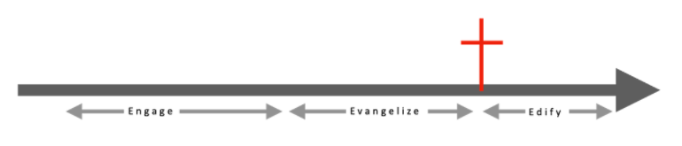

Slide 145
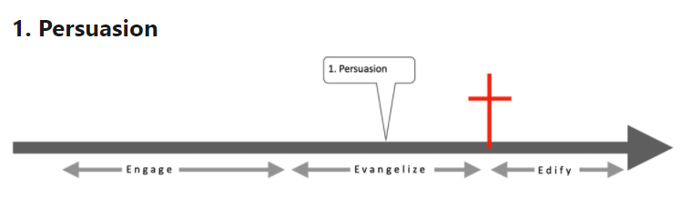

Slide 146
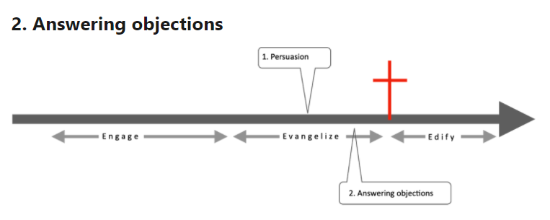

Slide 147
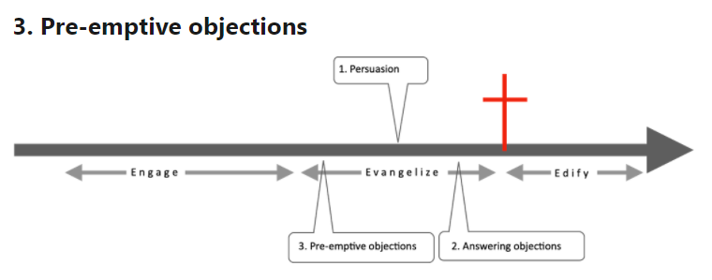

Slide 148
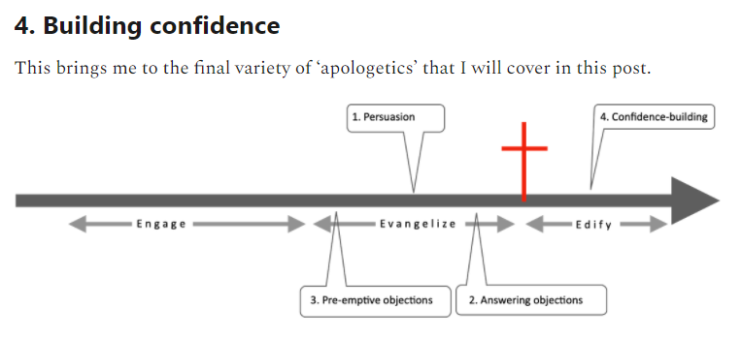

Slide 149
Tony Payne, Seven types of 'apologetics': Part 2: God talk, 'positive apologetics' and prosecution—plus some thoughts on why we've become so 'apologetic’ (July 14, 2021)
Persuasion: the reason and argument that takes place when we are actually presenting the gospel.
Answering objections: responding to the questions, objections and accusations that arise in response to the gospel.
Pre-emptive objections: clearing away obstacles or objections before we get to actually explaining the gospel.
Building confidence in Christians by fortifying them against the attacks and objections of the world.

Slide 150
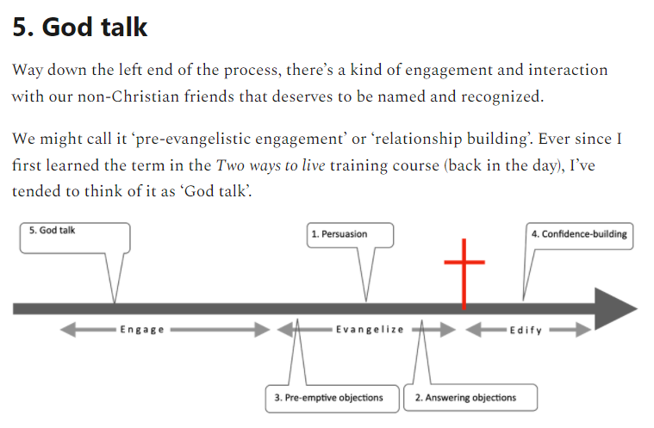

Slide 151
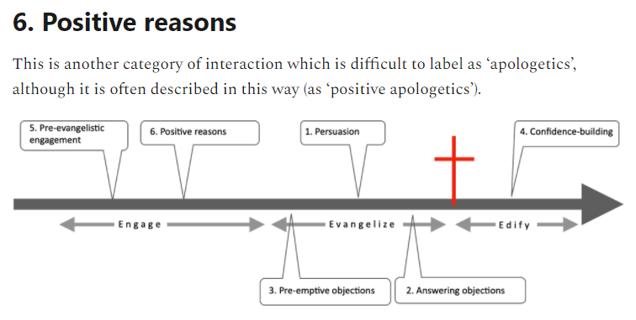

Slide 152
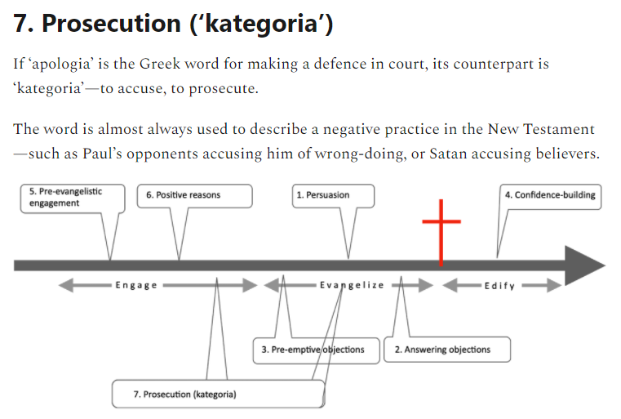

Slide 153
Tactics in Defending the Faith: Columbo
Greg Koukl
Stand To Reason, Founder and President

Slide 154
The Columbo tactic asks one opening question, requesting permission, with two important follow up questions.
May I ask you a question?

Slide 155
What do you mean by that? (or some variation)
This question accomplishes five important objectives.
It immediately engages the non-believer in an interactive way.
It flatters the non-believer because it shows genuine interest in his or her view.
It forces the non-believer to think more carefully and more precisely maybe for the first time about his intended meaning.
It gives you valuable information about the non-believer’s exact position.
It positions the non-believer in the defensive position while placing you in control of the conversation.

Slide 156
How did you come to that conclusion?
This question graciously assumes that the non-believer has actually reached a conclusion that he has reasons for his view and has not merely asserted it carte-blanche. It will give him a chance to express his rationale, if he has one. It will also give you more material to work with in addressing his objections. It ultimately shifts the burden of proof to the other person, which is where it often belongs.
The key to this step is paying close attention to the answer to the question, “How did you come to that conclusion?”
Are there any blatant weaknesses in the view?
Do the conclusions follow from the evidence?
Can you question any underlying assumptions?
Is there a misstep, a non-sequitur, a fallacy, or a failing of some sort?

Slide 157
Two Ways to Live

Slide 158
Tony Payne, Changes to 'Two Ways to Live'

Slide 159


Slide 160
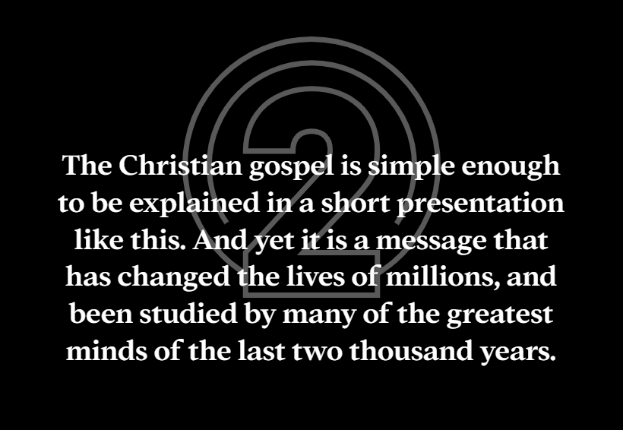

Slide 161
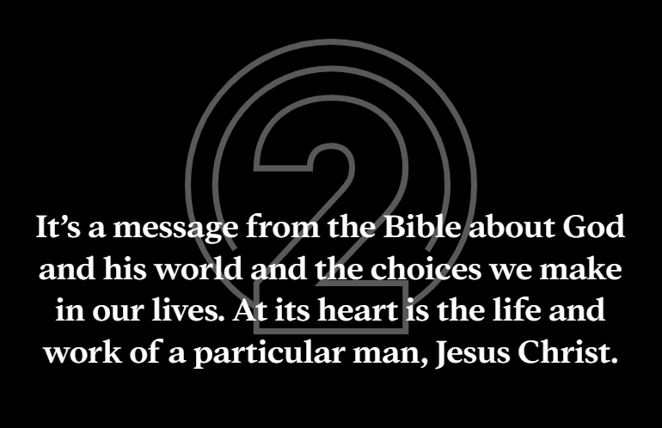

Slide 162
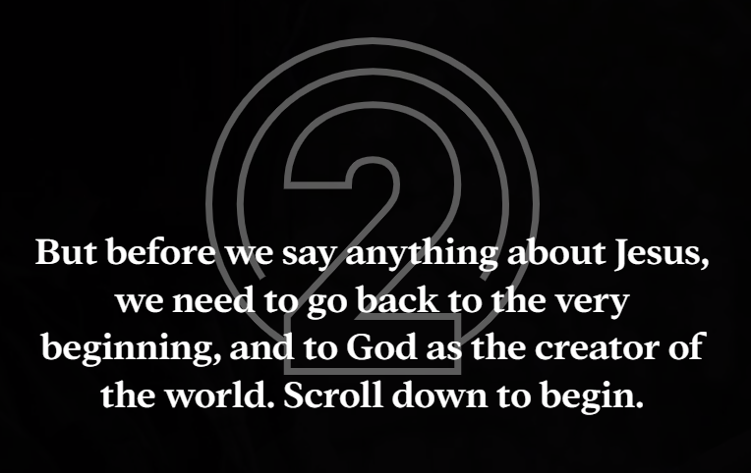

Slide 163


Slide 164
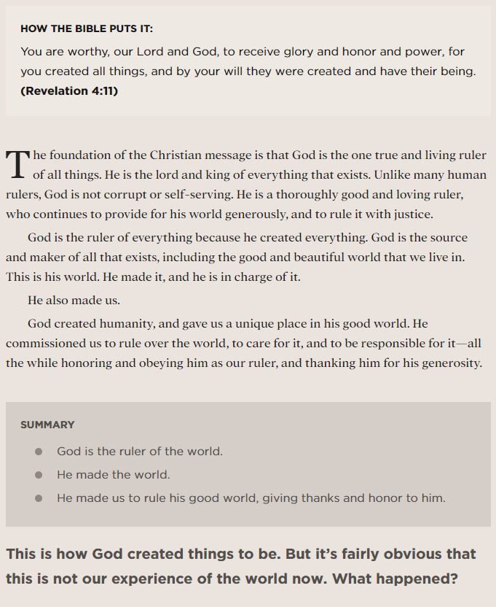

Slide 165


Slide 166
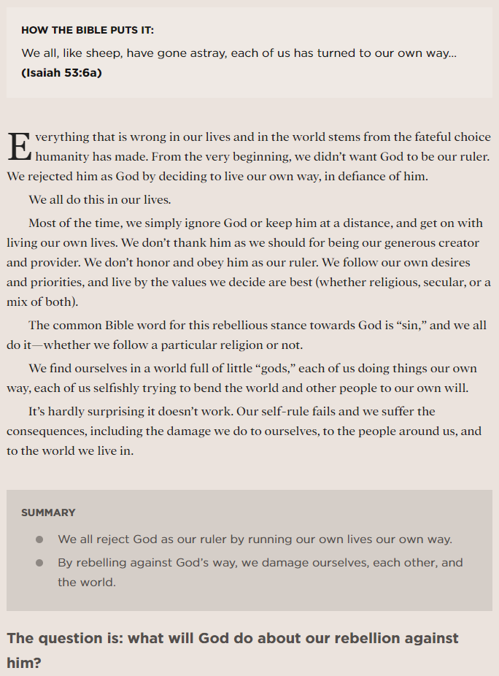

Slide 167


Slide 168
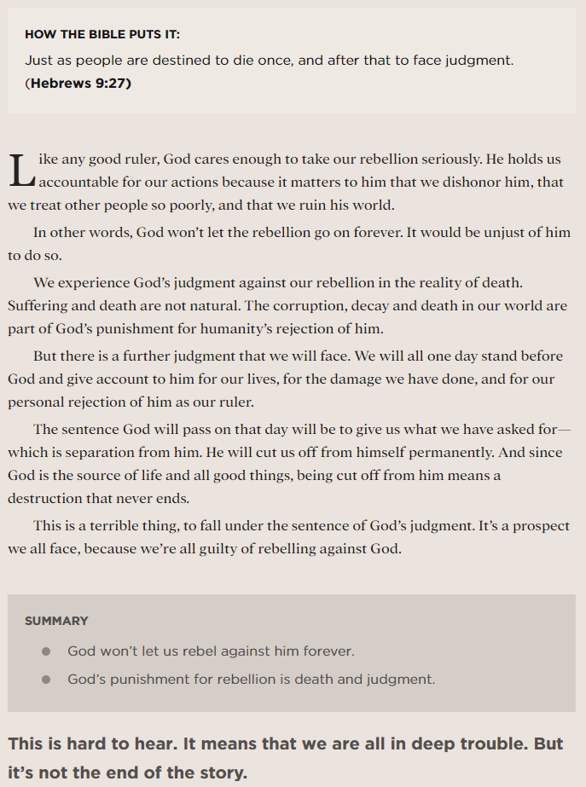

Slide 169


Slide 170
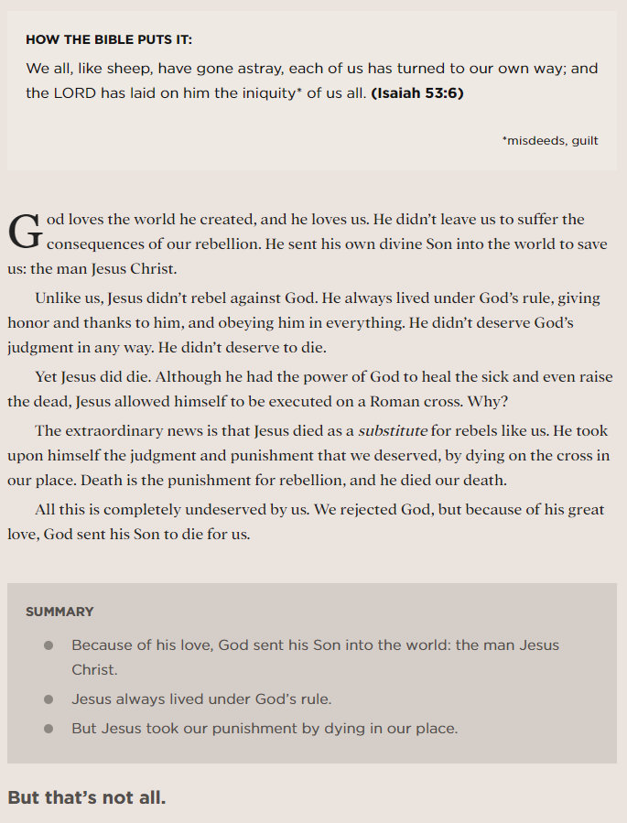

Slide 171


Slide 172
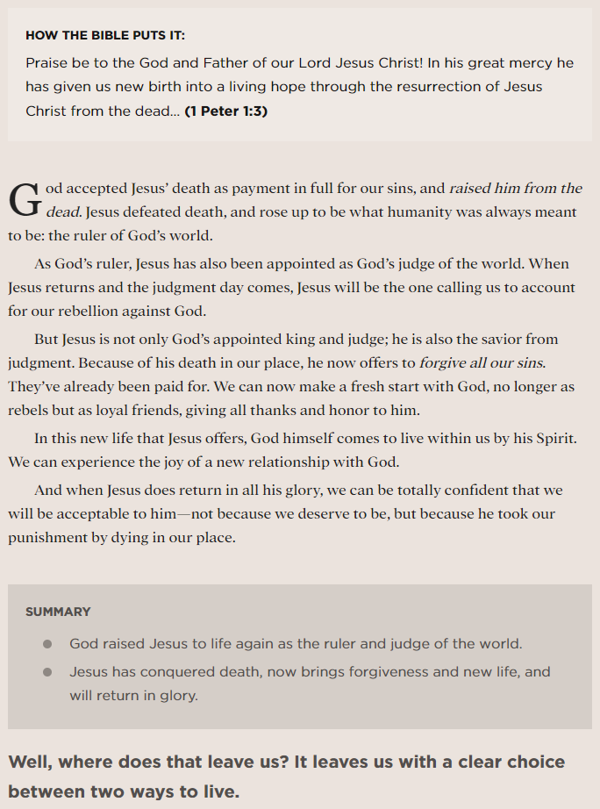

Slide 173


Slide 174
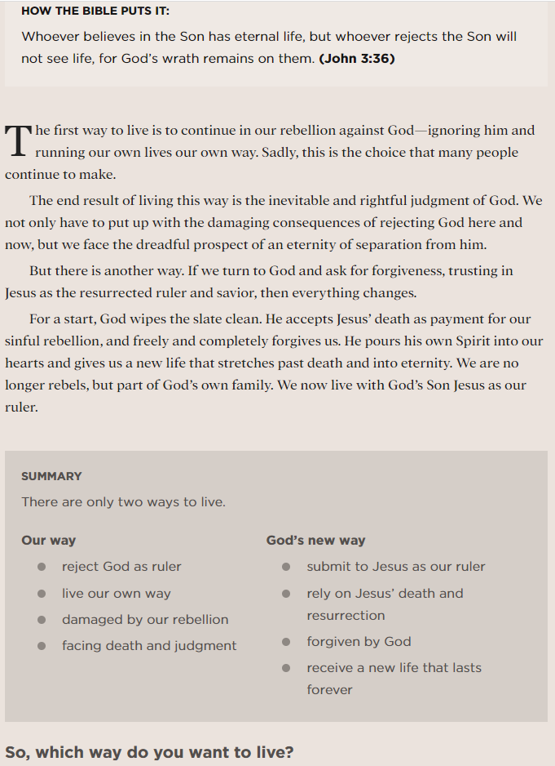

Slide 175
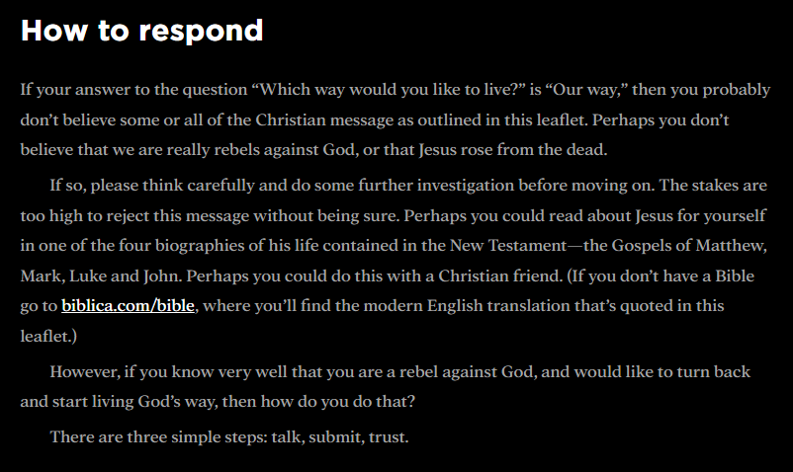

Slide 176
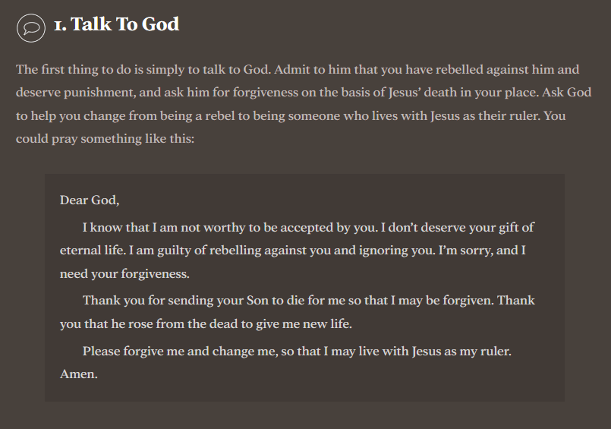

Slide 177
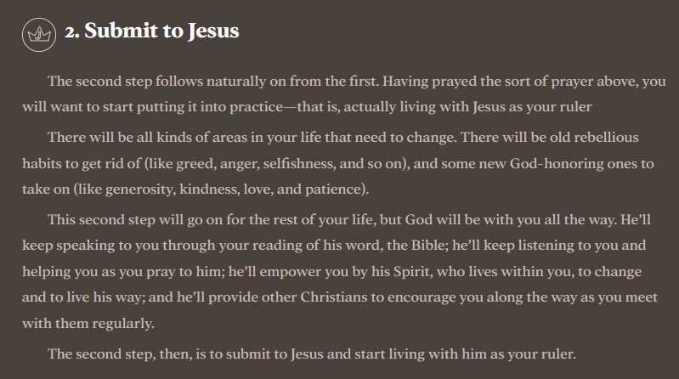

Slide 178
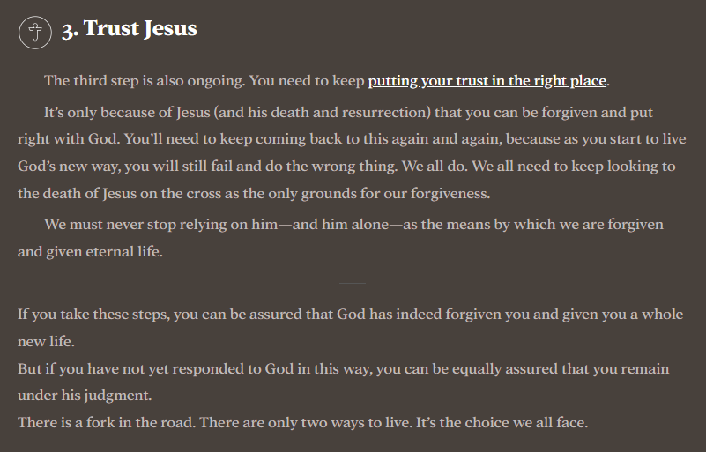

Slide 179
18 Prayers to Pray for Unbelievers

Slide 180
Prayers for Salvation

Slide 181
Pray that God would circumcise their hearts. Circumcision was the Old Testament sign of entering into God’s covenant, of being God’s people. To have a circumcised heart symbolizes having a heart that is fully joined to God, fully submissive to him. “And the LORD your God will circumcise your heart and the heart of your offspring, so that you will love the LORD your God with all your heart and with all your soul, that you may live” (Deuteronomy 30:6).

Slide 182
Pray that God would give them a heart of flesh. The Bible contrasts a heart of flesh, a heart that is alive and responsive to God, to a heart of stone, a heart that is cold and unyielding. Pray that God would work within these unbelievers to change their hearts. “And I will give them one heart, and a new spirit I will put within them. I will remove the heart of stone from their flesh and give them a heart of flesh…” (Ezekiel 11:19).

Slide 183
Pray that God would put his Spirit within them. The great joy of salvation is being indwelled by God himself. Pray that God would grant this honor to those unbelievers, that he would choose to take up residence within them. “And I will put my Spirit within you, and cause you to walk in my statutes and be careful to obey my rules” (Ezekiel 36:27).

Slide 184
Pray that they would come to Christ. If unbelievers are to come to salvation, there is just one way. They must come through Christ and Christ alone. “Jesus said to him, ‘I am the way, and the truth, and the life. No one comes to the Father except through me’” (John 14:6). Remember, too, that he is the one who calls them to come and to be relieved of the burden of their sin (see Matthew 11:28-30).

Slide 185
Pray that God would open their hearts to believe the gospel. Once more, God must initiate and people must respond. So pray that God would open the hearts of these unbelievers so they can in turn believe, just as Lydia did. “The Lord opened her heart to pay attention to what was said by Paul” (Acts 16:14).

Slide 186
Pray that God would free them from the slavery of sin. Unbelievers may believe they are free, but they are in fact enslaved. They are slaves of sin, bound by their sin and sinfulness. Pray that God would liberate them by his gospel. “But thanks be to God, that you who were once slaves of sin have become obedient from the heart to the standard of teaching to which you were committed” (Romans 6:17).

Slide 187
Pray that God would remove Satan’s blinding influence . Unbelievers have been blinded by Satan and will only ever be able to see and appreciate the gospel if God works within them. So pray that God would give them sight—spiritual sight. “In their case the god of this world has blinded the minds of the unbelievers, to keep them from seeing the light of the gospel of the glory of Christ, who is the image of God” (2 Corinthians 4:4).

Slide 188
Pray that God would grant them repentance. Unbelievers cannot repent without the enabling grace of God. So pray that God would grant them repentance, that this repentance would lead them to a knowledge of the truth. The purpose or end-goal of “God's kindness is meant to lead you to repentance” (Rom. 2:4).

Slide 189
Pray that they would come to their senses and that they would escape from the devil’s snare. “God may perhaps grant them repentance leading to a knowledge of the truth, and they may come to their senses and escape from the snare of the devil, after being captured by him to do his will” (2 Timothy 2:25-26).

Slide 190
Prayers for Yourself

Slide 191
Pray that you will develop relationship with them. For people to be saved they must first hear the good news of the gospel. For them to hear the good news of the gospel, they must first encounter Christians—Christians like you. Pray that you would develop deeper, more significant relationship with them so you can, in turn, speak truth. “How then will they call on him in whom they have not believed? And how are they to believe in him of whom they have never heard? And how are they to hear without someone preaching?” (Romans 10:14).

Slide 192
Pray for opportunities to minister to them. Many people come to faith after seeing Christ’s loved displayed through the ministry of Christians. Pray for opportunities to minister to unbelievers so that your ministry can have an evangelistic effect. “In the same way, let your light shine before others, so that they may see your good works and give glory to your Father who is in heaven” (Matthew 5:16).

Slide 193
Pray for them faithfully and persistently. Our temptation is to grow discouraged in prayer, to pray for a while and, when we see no visible results, to give up. But God calls us to persevere in prayer. “Continue steadfastly in prayer, being watchful in it with thanksgiving” (Colossians 4:2). (See also the parable of the persistent widow in Luke 18:1-8.)

Slide 194
Pray for a burden to plead for their souls. Paul was willing to tell the church at Rome of his great longing to see the salvation of the lost. Do you share this deep longing? Pray that God would give you a great burden for souls. “Brothers, my heart’s desire and prayer to God for them is that they may be saved” (Romans 10:1).

Slide 195
Pray for boldness in generating and taking opportunities to speak the gospel. Even Paul longed for this boldness and for the confidence that he was speaking the right and best words. Pray that God would give you the boldness and, that when you take the opportunities, that he would then guide your words. “[Pray] also for me, that words may be given to me in opening my mouth boldly to proclaim the mystery of the gospel…” (Ephesians 6:19).

Slide 196
Pray for other believers to encounter them. God almost always uses a succession of people to share the gospel with people before they are saved. Pray, then, that God would lead other Christians into the lives of the unbelievers you love, that they too would provide an example of Christian living and that they too would speak the gospel. “I planted, Apollos watered, but God gave the growth” (1 Corinthians 3:6).

Slide 197
Other Pertinent Prayers

Slide 198
Pray that God would use any circumstance to do his work in them. We pray to a God who is sovereign and who sovereignly works his good will. Often he saves people through difficult circumstances, through bringing them to the very end of themselves. Pray, then, that God would arrange circumstances, whether easy or difficult, to lead them to salvation. “Before I was afflicted I went astray, but now I keep your word” (Psalm 119:67). As you pray for the unbelievers you love, always pray to God: “your will be done, on earth as it is in heaven” (Matthew 6:10).

Slide 199
Pray that God would extend his mercy to them. God assures us that he wishes for all people to turn to him in repentance and faith. He receives no joy from seeing people perish. Pray, then, that God would be glorified in the salvation of these people. “The Lord is not slow to fulfill his promise as some count slowness, but is patient toward you, not wishing that any should perish, but that all should reach repentance” (2 Peter 3:9).

Slide 200
Pray with confidence. Finally, pray with confidence. God expects we will pray, God invites us to pray, God commands us to pray. Why? Because God loves to hear us pray and God loves to respond to our prayers. So as you pray for unbelievers, pray with confidence that God hears your prayers. “The prayer of a righteous person has great power as it is working” (James 5:16).

Slide 201
A Few Resources

Slide 202
Sam Allberry, Is God anti-gay?: And Other Questions About Homosexuality, the Bible and Same-Sex Attraction, rev. ed. (Good Book Company, 2013).
Timothy Beougher, Invitation to Evangelism: Sharing the Gospel with Compassion and Conviction
Sam Chan, Evangelism in a Skeptical World: How to Make the Unbelievable News about Jesus More
Joshua D. Chatraw, Telling a Better Story: How to Talk About God in a Skeptical Age (Grand Rapids: Zondervan, 2020).
Joshua D. Chatraw and Mark D. Allen, Apologetics at the Cross: An Introduction for Christian Witness (Grand Rapids: Zondervan, 2018). Cf. Doing Apologetics Like Augustine Did
Joshua D. Chatraw and Karen Swallow Prior, ed., Cultural Engagement: A Crash Course in Contemporary Issues (Grand Rapids: Zondervan Academic, 2019).
Elliot Clark, Evangelism as Exiles: Life on Mission as Strangers in our Own Land
Paul Copan, Is God a Moral Monster?: Making Sense of the Old Testament God (Grand Rapids: Baker Books, 2011).
Paul M. Gould, Cultural Apologetics: Renewing the Christian Voice, Conscience, and Imagination in a Disenchanted World (Grand Rapids: Zondervan Academic, 2019).
David M. Gustafson, Gospel Witness: Evangelism in Word and Deed
David M. Gustafson, Gospel Witness Through the Ages: A History of Evangelism
Timothy Keller, The Reason for God: Belief in an Age of Skepticism (New York: Penguin Books, 2008).
Timothy Keller, Making Sense of God: An Invitation to the Skeptical (New York: Penguin Books, 2018).

Slide 203
Michael Kruger, Surviving Religion 101: Letters to a Christian Student on Keeping the Faith in College
Eric Mason, ed., Urban Apologetics: Restoring Black Dignity with the Gospel (Grand Rapids: Zondervan, 2021).
Alister E. McGrath, Narrative Apologetics: Sharing the Relevance, Joy, and Wonder of the Christian Faith (Grand Rapids: Baker Books, 2019).
Rebecca McLaughlin, Confronting Christianity: 12 Hard Questions for the World's Largest Religion
Randy Newman, Questioning Evangelism: Engaging People's Hearts the Way Jesus Did
Randy Newman, Mere Evangelism: 10 Insights from C. S. Lewis to Help You Share Your Faith
Believable
Fred Sanders, The Deep Things of God: How the Trinity Changes Everything
Fred Sanders, Fountain of Salvation: Trinity and Soteriology
Daniel Strange, Their Rock Is Not Like Our Rock: A Theology of Religions
Daniel Strange, Making Faith Magnetic: Five Hidden Themes Our Culture Can't Stop Talking About... And How to Connect Them to Christ
David F. Wells, God the Evangelist: How the Holy Spirit Works to Bring Men and Women to Faith
Christopher Yuan, Holy Sexuality and the Gospel: Sex, Desire, and Relationships Shaped by God's Grand Story

Slide 204
Elliot Clark, The Apostles Never ‘Shared’ the Gospel, and Neither Should We
Aaron Earls, Evangelism Is More Prayer Than Action for Protestant Churchgoers
Rick Richardson, Do 47 Percent of Christian Millennials Think Evangelism Is Wrong?
Ed Stetzer, You Don't Accidentally Evangelize: If You Don’t Prioritize It, It Won’t Happen
Sam Storms, The Dirty Dozen: Some Thoughts on Why We Stink at Evangelism
Sarah Eekhoff Zylstra, Ask and You Shall Evangelize

Slide 205
Sam Allberry, Where to Find Hope and Help Amid the Sexual Revolution (November 5, 2018)
Hunter Beaumont, Deconstruct Your Culture, Not Your Faith (April 26, 2021)
Elliott Clark, It’s Time for a Holistic Apologetic (March 29, 2019)
Chris Colquitt, How Things Have Changed: Reflections of a Millennial Pastor in a Gen Z World (September 30, 2020)
Paul M. Gould, What Is Cultural Apologetics? (April 15, 2019)
Michael J. Kruger, Jen Hatmaker and the Power of Deconversion Stories (February 6, 2018)
Brett McCracken, Your Neighbor’s New Creed: “In This House, We Believe . . .” (October 5, 2020)
Carl Trueman, The Rise and Triumph of the Modern Self: And How the Church Can Respond (February 25, 2020)
Sarah Eekhoff Zylstra, Ask and You Shall Evangelize (November 14, 2018)
Sarah Eekhoff Zylstra, 6 Things Christians Should Know About Gen Z (February 15, 2022)

Slide 206
A Concluding Challenge

