Slide 1
Scott Barber
Director of Pastoral Theology & Care
Scott.barber@efca.org

Slide 2
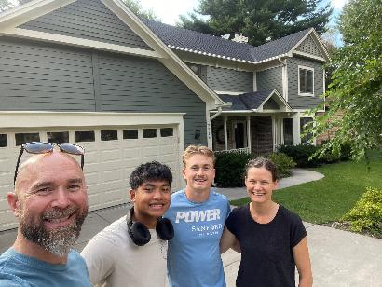
The Barber Family
Married to Jane for 22 years
Ian – 19 studying Youth Ministry @ UNW
Xander -17 junior in HS

Slide 3
1 Timothy 4:15–16 (ESV)
¹⁵Practice these things, immerse yourself in them, so that all may see your progress. ¹⁶Keep a close watch on yourself (life) and on the teaching (doctrine). Persist in this, for by so doing you will save both yourself and your hearers.

Slide 4
1 Peter 5:2–3 (ESV)
²shepherd the flock of God that is among you, exercising oversight, not under compulsion, but willingly, as God would have you; not for shameful gain, but eagerly; ³not domineering over those in your charge, but being examples to the flock.

Slide 5
We are Sheep before we are shepherds… We are recipients of the Gospel before we are Ministers of the gospel

Slide 6
If it Ain’t, Broke Fix It
Proactive self-shepherding

Slide 7
God’s Glory and his Grace compel us to a lifestyle of proactively step toward Christ in every situation and season… in sin, suffering, stress, stability, and success.

Slide 8
Practices of Proactive Self-Shepherding
Possessing a Grace-filled Growth Mindset
Regularly Examining your soul for Spirit-led living
Cultivating A lifestyle of Sabbath Rest
Being connected in gospel community
Scheduling your self-shepherding practices

Slide 9
Grace-Filled, Growth Mindset

Slide 10
“If it ain’t broke, don’t fix it”
Health is the absence of pain and problems
We won’t seek to change unless the pain of staying the same exceeds the pain of change.

Slide 11
1 Thessalonians 4:1–3 (ESV)
^{“1}Finally, then, brothers, we ask and urge you in the Lord Jesus, that as you received from us how you ought to walk and to please God, just as you are doing, that you do so more and more. ²For you know what instructions we gave you through the Lord Jesus. ³For this is the will of God, your sanctification…”

Slide 12
Proverbs 6:6–11 (ESV)
⁶Go to the ant, O sluggard; consider her ways, and be wise.
⁷Without having any chief, officer, or ruler,
⁸she prepares her bread in summer and gathers her food in harvest.
⁹How long will you lie there, O sluggard? When will you arise from your sleep?
¹⁰A little sleep, a little slumber, a little folding of the hands to rest,
¹¹and poverty will come upon you like a robber, and want like an armed man.

Slide 13
Titus 2:11–13 (ESV)
¹¹For the grace of God has appeared, bringing salvation for all people, ¹²training us to renounce ungodliness and worldly passions, and to live self-controlled, upright, and godly lives in the present age, ¹³waiting for our blessed hope, the appearing of the glory of our great God and Savior Jesus Christ,

Slide 14
God’s Glory and his Grace compel us to a lifestyle of proactively step toward Christ in every situation and season… in sin, suffering, stress, stability, and success.

Slide 15
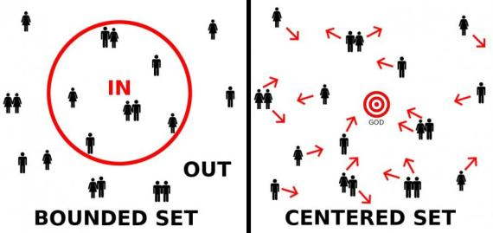
Bounded set vs Center Set

Slide 16
Philippians 3:8–17 (ESV)
⁸Indeed, I count everything as loss because of the surpassing worth of knowing Christ Jesus my Lord. For his sake I have suffered the loss of all things and count them as rubbish, in order that I may gain Christ ⁹and be found in him, not having a righteousness of my own that comes from the law, but that which comes through faith in Christ, the righteousness from God that depends on faith— ¹⁰that I may know him and the power of his resurrection, and may share his sufferings, becoming like him in his death, ¹¹that by any means possible I may attain the resurrection from the dead. ¹²Not that I have already obtained this or am already perfect, but I press on to make it my own, because Christ Jesus has made me his own.

Slide 17
Philippians 3:8–17 (ESV)
¹³Brothers, I do not consider that I have made it my own. But one thing I do: forgetting what lies behind and straining forward to what lies ahead, ¹⁴I press on toward the goal for the prize of the upward call of God in Christ Jesus. ¹⁵Let those of us who are mature think this way, and if in anything you think otherwise, God will reveal that also to you. ¹⁶Only let us hold true to what we have attained. ¹⁷Brothers, join in imitating me, and keep your eyes on those who walk according to the example you have in us.

Slide 18
How Does your mindset about your own discipleship Journey need to shift to encourage your growth?

Slide 19
What is your instinctive response to your sin, shame, suffering, stress, stagnation, stability, or success?
Christ is present with you. How can you step toward Him in these situations or seasons?

Slide 20
In what areas do you need to cultivate a growth mind set?
Marriage
Parenting
Friendship
Physical Health
Mental Health
Personal Holiness & Spiritual Maturity
Professional Development (preaching, leading, counseling, etc.)
Equipping yourself and your church for conflict*

Slide 21
Proactive Self-Shepherding Practices or Resources
Spiritual Disciplines
Peer care and accountability
Counseling or Professional care
Coaching/Mentoring
Training
Rest and Retreat

Slide 22
Regularly Examine your soul for Spirit-led living

Slide 23
“Check yourself before you wreck your self”
Ice Cube

Slide 24
Watch your life… through assessment
Psalm 139:23–24 (ESV)
²³Search me, O God, and know my heart! Try me and know my thoughts! ²⁴And see if there be any grievous way in me, and lead me in the way everlasting!

Slide 25
Watch your life… through assessment
1 Peter 5:8 (ESV)
⁸Be sober-minded; be watchful. Your adversary the devil prowls around like a roaring lion, seeking someone to devour. ⁹Resist him, firm in your faith, knowing that the same kinds of suffering are being experienced by your brotherhood throughout the world.

Slide 26
When we grow in self-awareness we grow in our ability to discern the presence of our flesh, Satan and the Spirit in order that we may depend on and follow the Spirit and also walk with others well

Slide 27
Watch your life… through assessment
Emotionally Healthy Leader – Personal Assessment
  https://www.emotionallyhealthy.org/leadership-assessment/
  https://www.emotionallyhealthy.org/mature/personal-assessment/
Flourishing in Ministry Assessment
  https://www.flourishinginministry.org/assessment
  The Flourishing in Ministry Assessment helps you understand how well you're doing in each of the four Flourishing dimensions: Daily Wellbeing, Resilience, Thriving, and Authenticity. You'll receive your score on each of those dimensions as well as resources to help you sustain or improve your level of flourishing.

Slide 28
Practicing a Lifestyle of Sabbath Rest
Working from rest, instead of working for rest

Slide 29

Pastors can often feel stuck on a hamster wheel of survival mode in ministry.

Slide 30
Two lies Satan tempts pastors and ministry leaders to believe that keep them stuck in survival mode and drive them to burnout:
  I am invincible… “I can do it all” or “I should do it all”
  I am irreplaceable… “I am necessary” or “I should be needed”

Slide 31
Factors that Deplete Helping Professionals
Compassion Fatigue
Decision Making Fatigue

Slide 32
Mike Minter - Why Sabbath Is for Pastors, Too
“To be a good pastor, you’ll need the strength of an ox, the daring of a lion, the harmlessness of a dove, the gentleness of a sheep, the vision of an eagle, the perspective of a giraffe, the endurance of a camel, the stomach of a horse, the faithfulness of a prophet, the fervency of an evangelist, the tenacity of a bulldog, the wisdom of an owl, the industry of a beaver, the head of a scholar, the hide of a rhinoceros, the heart of a child, and the devotion of a mother. Is it any wonder why pastors need Sabbath rest?”
https://research.lifeway.com/2025/04/10/why-sabbath-is-for-pastors-too/

Slide 33
Pastors & Compassion Fatigue by Sam Rainer
You will never fulfill the minimum expectations of your church. There will always be someone (or many people!) who thinks you should spend more time in a particular area. What can you do? Set a reasonable weekly workload and delegate responsibilities as you train and equip your congregants. Will you please everyone? No, but trying to please everyone is precisely how compassion fatigue begins.
https://churchanswers.com/blog/how-pastors-get-compassion-fatigue-plus-ways-to-overcome-it/

Slide 34
What doctors wish patients knew about decision fatigue by Lisa MacLean, MD
Decision fatigue is “the idea that after making many decisions, your ability to make more decisions over the course of a day becomes worse. The more decisions you have to make, the more fatigue you develop and the more difficult making decisions can become.
“All of these decisions can create stress by the time the average person goes to bed, they’ve made over 35,000 decisions and all of those decisions take time and energy, and certainly can deplete us.”
https://www.ama-assn.org/public-health/behavioral-health/what-doctors-wish-patients-knew-about-decision-fatigue

Slide 35
What doctors wish patients knew about decision fatigue by Lisa MacLean, MD
“The more choices you have to make, the more it can wear on your brain, and it may cause your brain to look for short cuts. There are four main symptoms: procrastination, impulsivity, avoidance and indecision.”
“You are either putting the decision off until later, making a rash decision based on little evidence, avoiding the decision altogether or battling back and forth between various choices. The psychological effects of decision fatigue can vary, potentially leading to difficulty making the right decisions, impulse buying or other avoidance behaviors.
https://www.ama-assn.org/public-health/behavioral-health/what-doctors-wish-patients-knew-about-decision-fatigue
https://pmc.ncbi.nlm.nih.gov/articles/PMC6119549/

Slide 36
Pastors & Compassion Fatigue by Sam Rainer
Isolation: Burdens are heavier when carried alone. A listening friend can relieve a lot of tension simply by hearing you express frustration. A struggling pastor needs someone to hear words and not say words. When pastors serve in isolation, they receive words from their congregants but have nowhere to share their own words. Tension builds when you have no outlet to share.
No Margin: The calendar fills quickly with requests for time—counseling, weddings, and meetings. Each is important because they come from people in your church. Then, a couple of emergencies occur, and you are at the hospital late. A teen runs away. You help find her. A spouse confesses adultery. You are on the phone for two hours on Saturday. After a few sleepless nights, you’re drained. Sounds like a tough week? No, it’s every week.

Slide 37
Practicing a Lifestyle of Sabbath Rest
Working from rest, instead of working for rest

Slide 38
Sabbath Principles:
Exodus 20:8–11; Deuteronomy 5:14-15
Receiving our limits – “I am not God”
  I surrender to God, as my Sovereign Creator and King
Receiving our need for rest - “I need and trust God”
  I trust in and depend on God to work in me, for me and around me

Slide 39
Jesus and Sabbath Rest
Sabbath Rest is a lifestyle of surrender to and rest in Christ, as well as a scheduled (holy) rhythm
  Mark 2:23-28, Matt 11:28-30, Matt 5:17
Sabbath rest is spiritual, physical, psychological, relational, social, and vocational in practice and impact

Slide 40
Don’t Blow Up Your Ministry by Michael MacKenzie
“The commandment most of us break without batting an eye is “Keep the Sabbath.” Taking our time off reveals so much about how we are doing. It can give us opportunity to rest and reflect. Whether we allow ourselves to take a break tells us a lot about whether we are trusting God or taking the ministry on our own backs. During time off we can invest in relationships and our own hearts.”

Slide 41
“Pastors and Sabbath: The Importance of Rest” by Mark Dance
“Sabbath is a principle that we can and should apply every day when we go to bed, and every week when we choose to rest and worship, instead of work. We are serious about Sabbath when we refuse to check our voicemail, email, or any work correspondence on our day(s) off. Resting sounds easy, and it is for some. But for the busy pastor, rest is actually a bold, counter-cultural resistance to the American obsession with success. Sabbath literally means to “stop,” and that is not easy for us to do.”
https://research.lifeway.com/2014/01/23/pastors-and-sabbath-the-importance-of-rest/

Slide 42
How are you practicing and guarding Weekly Sabbath Rest?

Slide 43
Decision fatigue: less is more when making choices with patients – Alexandra Moorehouse
Decision fatigue in specialties such as emergency medicine is taken seriously. Breaks are rigorously enforced in many emergency departments (EDs) as it is acknowledged that clinicians making multiple decisions without a dedicated break (not using that break to check results or type notes) reach a point of diminishing returns where their decision making can become unsafe.
https://pmc.ncbi.nlm.nih.gov/articles/PMC7384807/
British Journal of General Practice

Slide 44
Margin is living with boundaries in our daily lives that lead us to trust and Depend on God as well as honor our limits

Slide 45
Margin helps leaders discern between what is urgent and what is important.
Margin helps equip leaders to resist doing more and instead be disciplined to do the most important things.

Slide 46
How can you build in margin each day to honor your limits and trust the Lord through Breaks, prayer, and planning?

Slide 47
Be connected in Gospel Community with others

Slide 48
Barna – Inside the Friendship Gap for Pastors
Relational Health Lags Behind Other Areas. Despite high scores in faith and vocation, pastors score lowest in relational well-being—yet few ask for help in this area.
Despite scoring lowest in relationships, pastors are most likely to say they need help with leadership development, spiritual growth and finances—areas where they already demonstrate relative strength. This is a major gap in pastors’ lives and support systems. However, they may be unaware (or unconcerned) that their relational health is falling behind.

Slide 49
Barna – Inside the Friendship Gap for Pastors
Loneliness isn’t always about being alone. For many pastors, it’s a deeper disconnect—feeling unseen or unsupported amid constant community. “This is a red flag for long-term sustainability in leadership,” Kinnaman notes. “Friendship, vulnerability, and spiritual direction aren’t luxuries—they’re lifelines.”
https://www.barna.com/trends/pastors-friendship-gap/

Slide 50
Biblical instruction for gospel community
But exhort one another every day, as long as it is called “today,” that none of you may be hardened by the deceitfulness of sin. - Hebrews 3:13
Therefore, confess your sins to one another and pray for one another, that you may be healed. The prayer of a righteous person has great power as it is working. - James 5:16

Slide 51
We receive forgiveness when we confess to the Lord, and we experience freedom when we confess to another.

Slide 52
Resilient Ministry by Burns, Chapman, Guthrie
“To whom can pastors go to get pastored without fear? Who is safe for pastors to talk about struggles and sins?”
“You are on the local shepherding committee for our denomination. If I told you how I was doing, you would be required to report me. And I can’t risk losing my job. So I can’t tell you have I’m doing.”

Slide 53
Resilient Ministry by Burns, Chapman, Guthrie
“Accountable relationships are necessary for spiritual growth. Pastors need brothers who are confidants: persons who can provide you with a place where you can say everything that’s in your heart, everything that’s on your mind, without being predigested or well packaged.”

Slide 54
The Care of Souls by Harold Senkbeil
“Find a pastor in who you can confide. Confess your sins. Pour out your regret, shame and remorse. That pastor will be your soul’s physician to for give your sins, to heal your wounds , and help you live in freedom.”

Slide 55
Don LeClere retired pastor (40 yrs), Marshall E-Free, Marshall, MN
I can honestly say that I would not have persevered in ministry without these other brothers by my side. To have men beside me to shoulder tragedy, conflict, shame and encouragement is indescribable. To do the same for them is the greatest joy.

Slide 56
James Allen Swan Lake E-free, Cottonwood, Mn
I think the greatest impact our cluster has had on my life personally is that it is the visible, tangible reminder of my own frailty, inadequacy, and dependence upon the gospel for my justification, within a community of grace. There are very few outlets that as a pastor I have access to where I can genuinely share the depths, hurts, struggles, and pains without wide-eyed shock from the people I'm called to shepherd and care for. Everyone sitting around the table, even if they're somewhat new, is in the same trenches, enduring the same calling, and carrying the same burdens. Church conflict, criticism, and division can quietly calcify my heart if I don't prevent it. Without a group of trusted men, weathering the same storms, disappointment and frustration can quickly turn into withdrawal, defensiveness, and even a loss of compassion.

Slide 57
Are you in Gospel community with other pastors? With Whom are you receiving Care, prayer and accountability?

Slide 58
Self-Shepherding needs to be planned so it can become a lifestyle

Slide 59
Proverbs 21:5
“The plans of the diligent lead surely to abundance, but everyone who is hasty comes only to poverty.”
We should assume that the diligent creatively plan within the framework of God’s revealed will and by nature act accordingly, but, marking the antithesis, the one who hastens to get rich acts without reckoning with the divine order.
  Bruce Waltke – NICNT - The Book of Proverbs, 2005

Slide 60
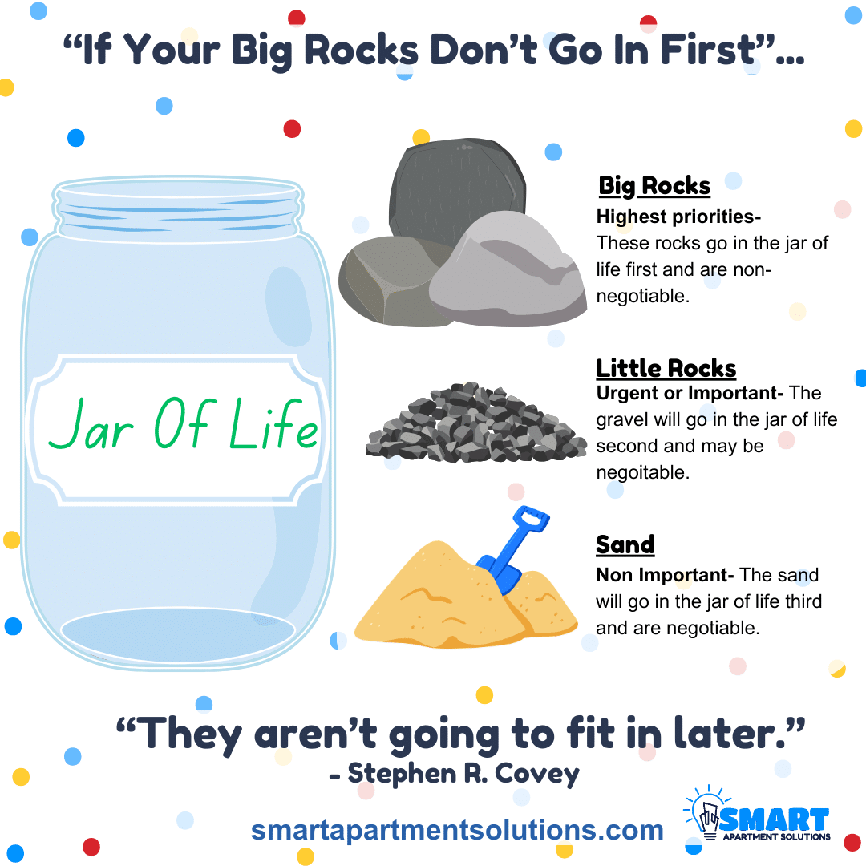
Steven Covey’s Big Rocks Illustration
What are the Big Rock priorities for your life and ministry role?

Slide 61
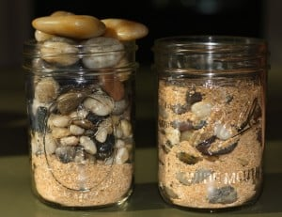
Steven Covey’s Big Rocks Illustration
Where are your Big Rocks scheduled into your week, month, year?

Slide 62
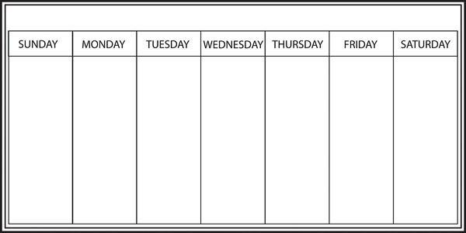
When will you Rest, Reflect, Plan, Pray, Connect & Play

Slide 63
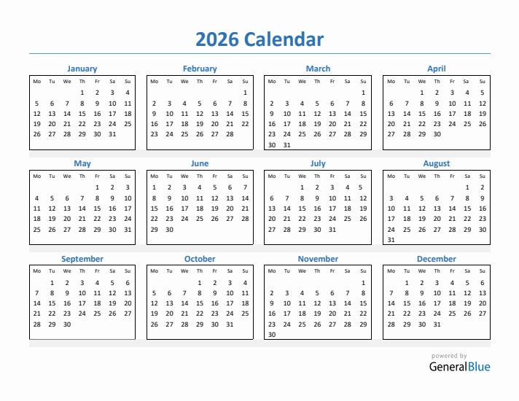
When will you Rest, Reflect, Plan, Pray, Connect & Play

Slide 64
If it Ain’t, Broke Fix It
Proactive self-shepherding

Slide 65
We are Sheep before we are shepherds… We are recipients of the Gospel before we are Ministers of the gospel

Slide 66
God’s Glory and his Grace compel us to a lifestyle of proactively step toward Christ in every situation and season… in sin, suffering, stress, stability, and success.

Slide 67
Proverbs 27:7 (ESV)
⁷One who is full loathes honey, but to one who is hungry everything bitter is sweet.
“Lord whatever it takes I want more of you, I want you have more of me and make me more like you.”

Slide 68
Practices of Proactive Self-Shepherding
Possessing a Grace-filled Growth Mindset
Examining your soul for Spirit-led living
Cultivating A lifestyle of Sabbath Rest
Being connected in gospel community
Scheduling your self-shepherding practices

Slide 69
Scott Barber
Director of Pastoral Theology & Care
Scott.barber@efca.org

